Slide 1
Any Questions about Tuesday’s Learning Objectives
Recall anatomical, biochemical, and functional evidence showing intimate relationships between hypothalamus and pituitary.
Describe how hormones are sensed by the neurons of the hypothalamus, and the role that the blood brain barrier and transport mechanisms play.
Recall how the central nervous system can integrate with the hypothalamus and modify both hormonal secretions and executive function.
Describe the differences in how hypothalamic signals are passed to the posterior and anterior pituitary glands.
List the known hypothalamic hormones which cause release (and release-inhibition) of anterior pituitary hormones, including their acronyms.
Name two major posterior pituitary hormones, their chemical category, and succinctly describe their secretory mechanism.
Describe cellular actions of vasopressin in terms of site of actions, receptors, and cellular signals.
Discuss briefly aquaporin water channels and relation to vasopressin.
Predict what the changes are expected in urine volume and osmolality and in ECF volume when vasopressin synthesis or secretion is severely impaired. Predict what will happen to water intake. Explain why there can be transient diabetes insipidus following a whiplash injury, and the rationale for therapy during this time.
Describe the control of vasopressin release.
Describe the function of oxytocin with respect to delivery and lactation.

Slide 2
Discuss with Folks Nearby
How could whiplash cause diabetes insipidus?
HINT: Relates to damage/severing of infundibulum
Notes:
Severed pituitary stalk -> low vasopressin -> low water reabsorbtion -> diabetes insipidus

Slide 3
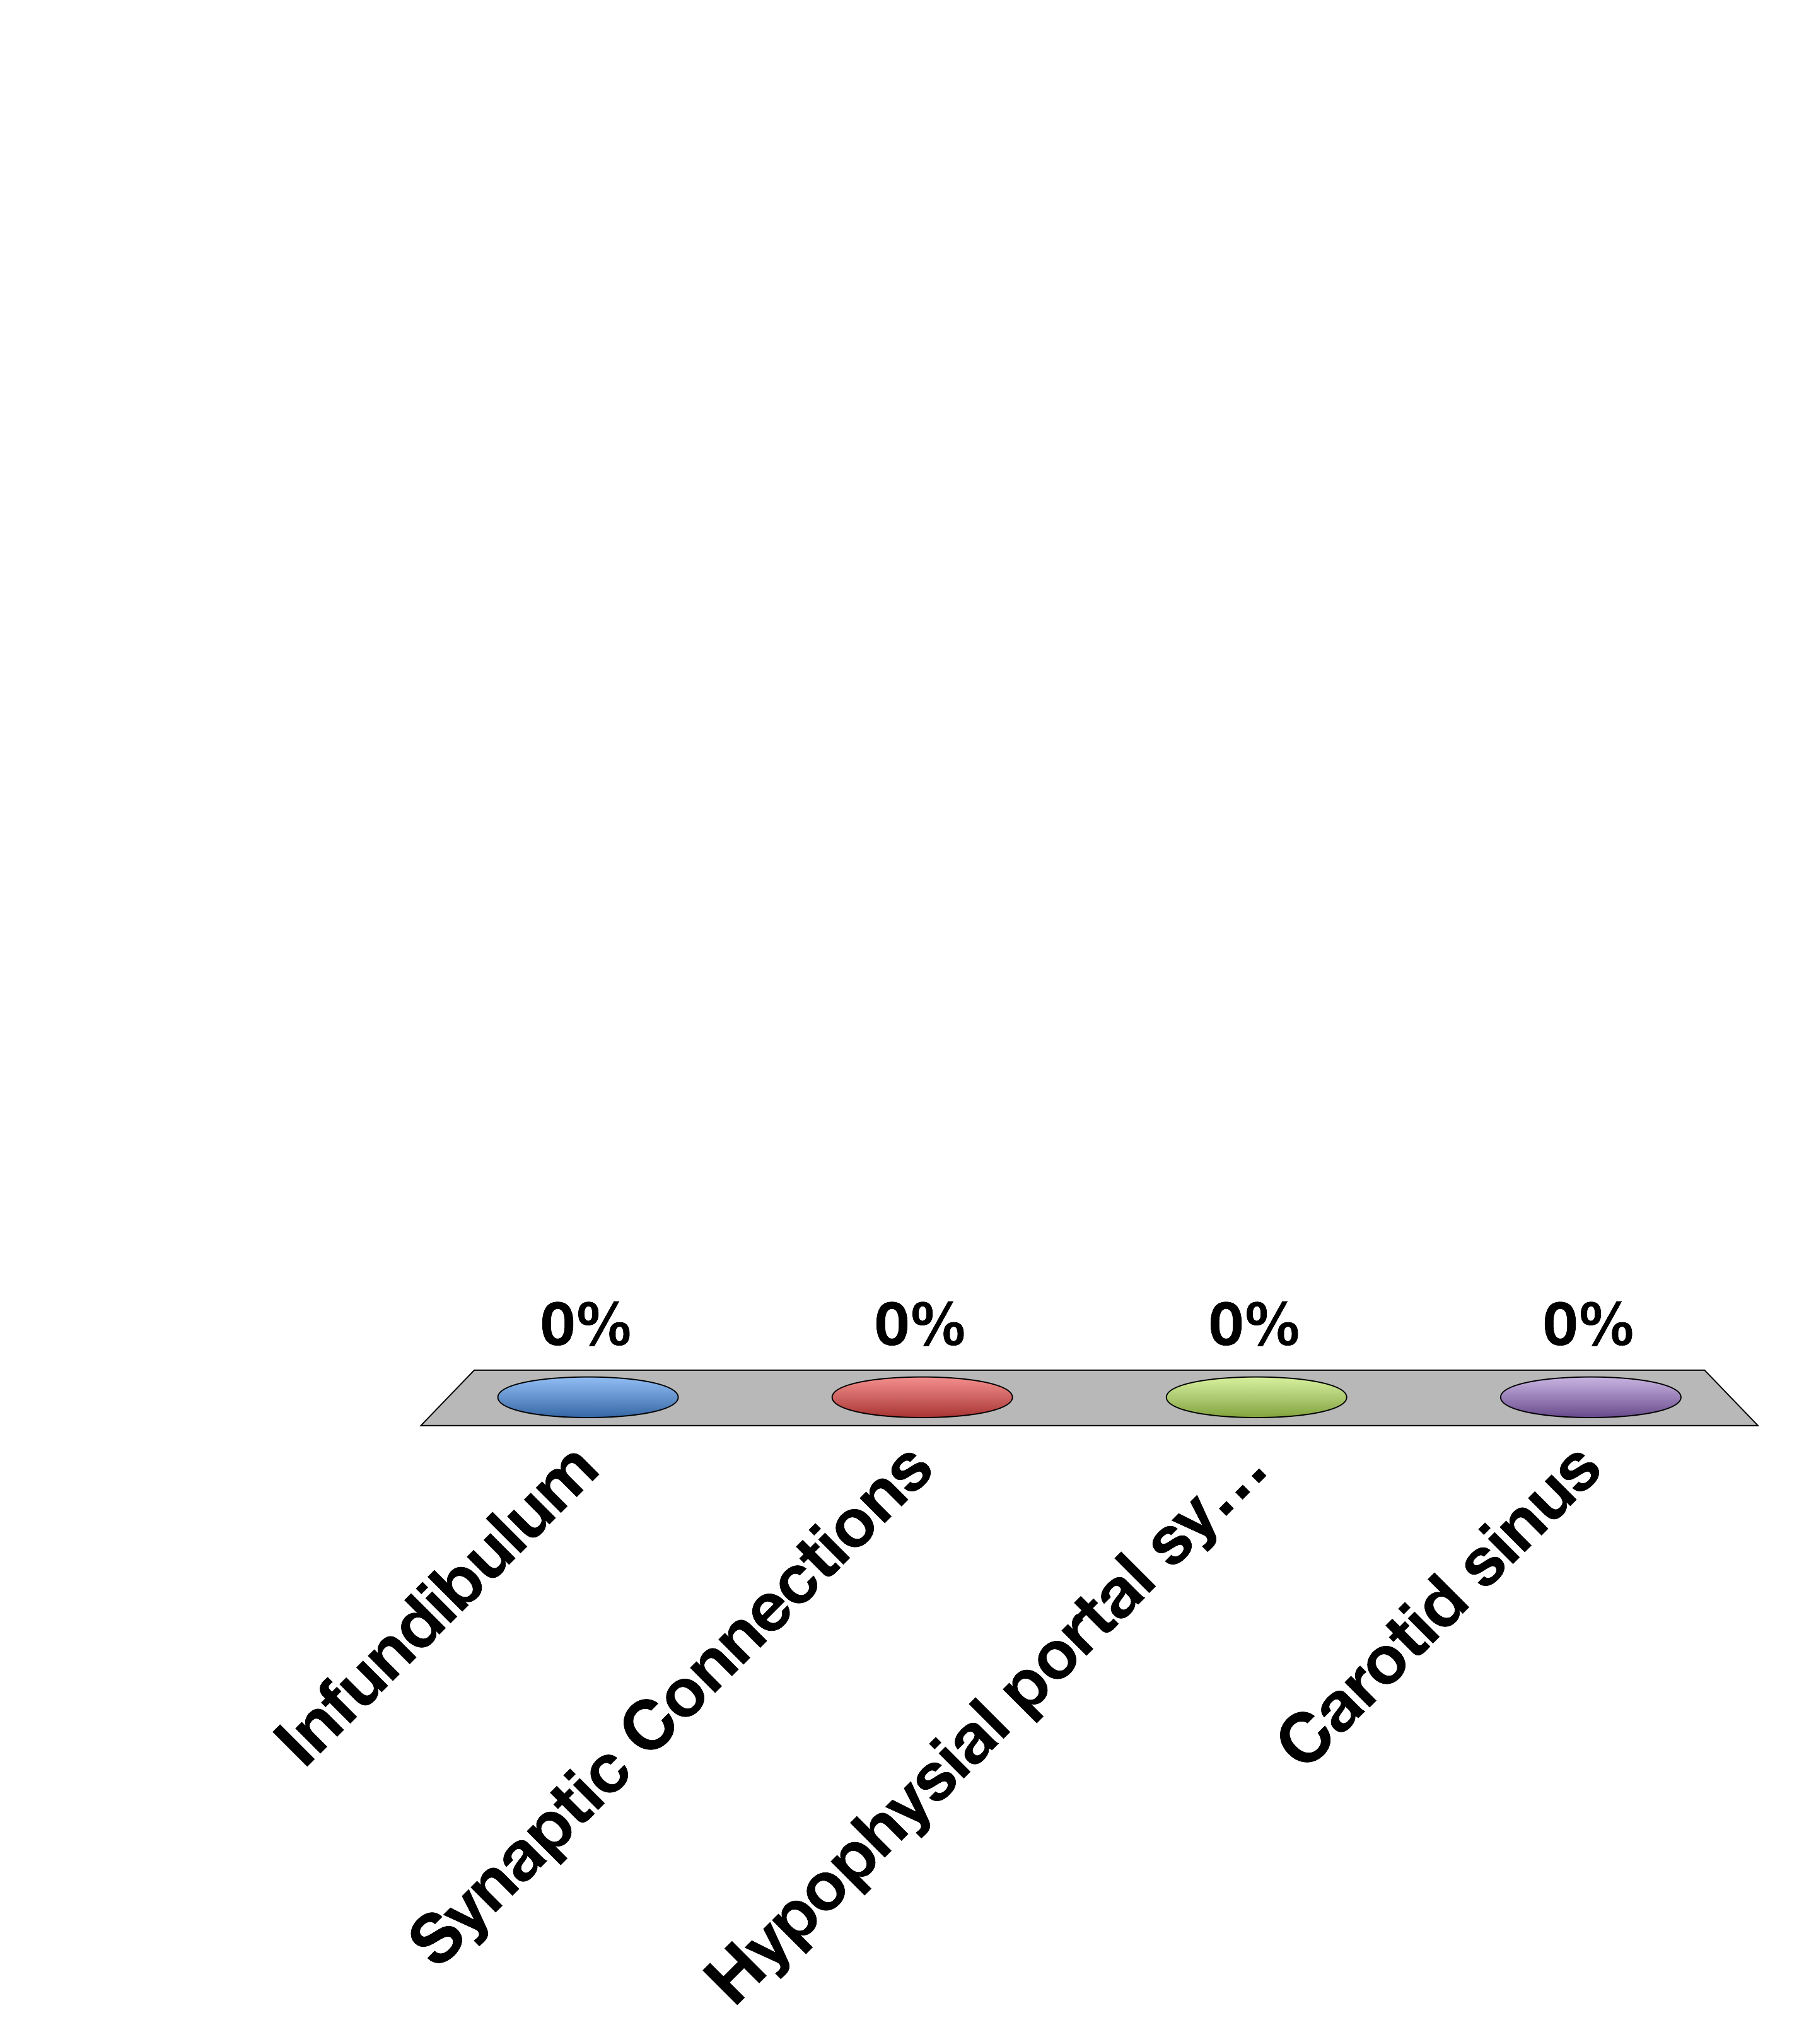
The Hypothalamus Connects to the Anterior Pituitary via the…
Infundibulum
Synaptic Connections
Hypophysial portal system
Carotid sinus
15

Slide 4
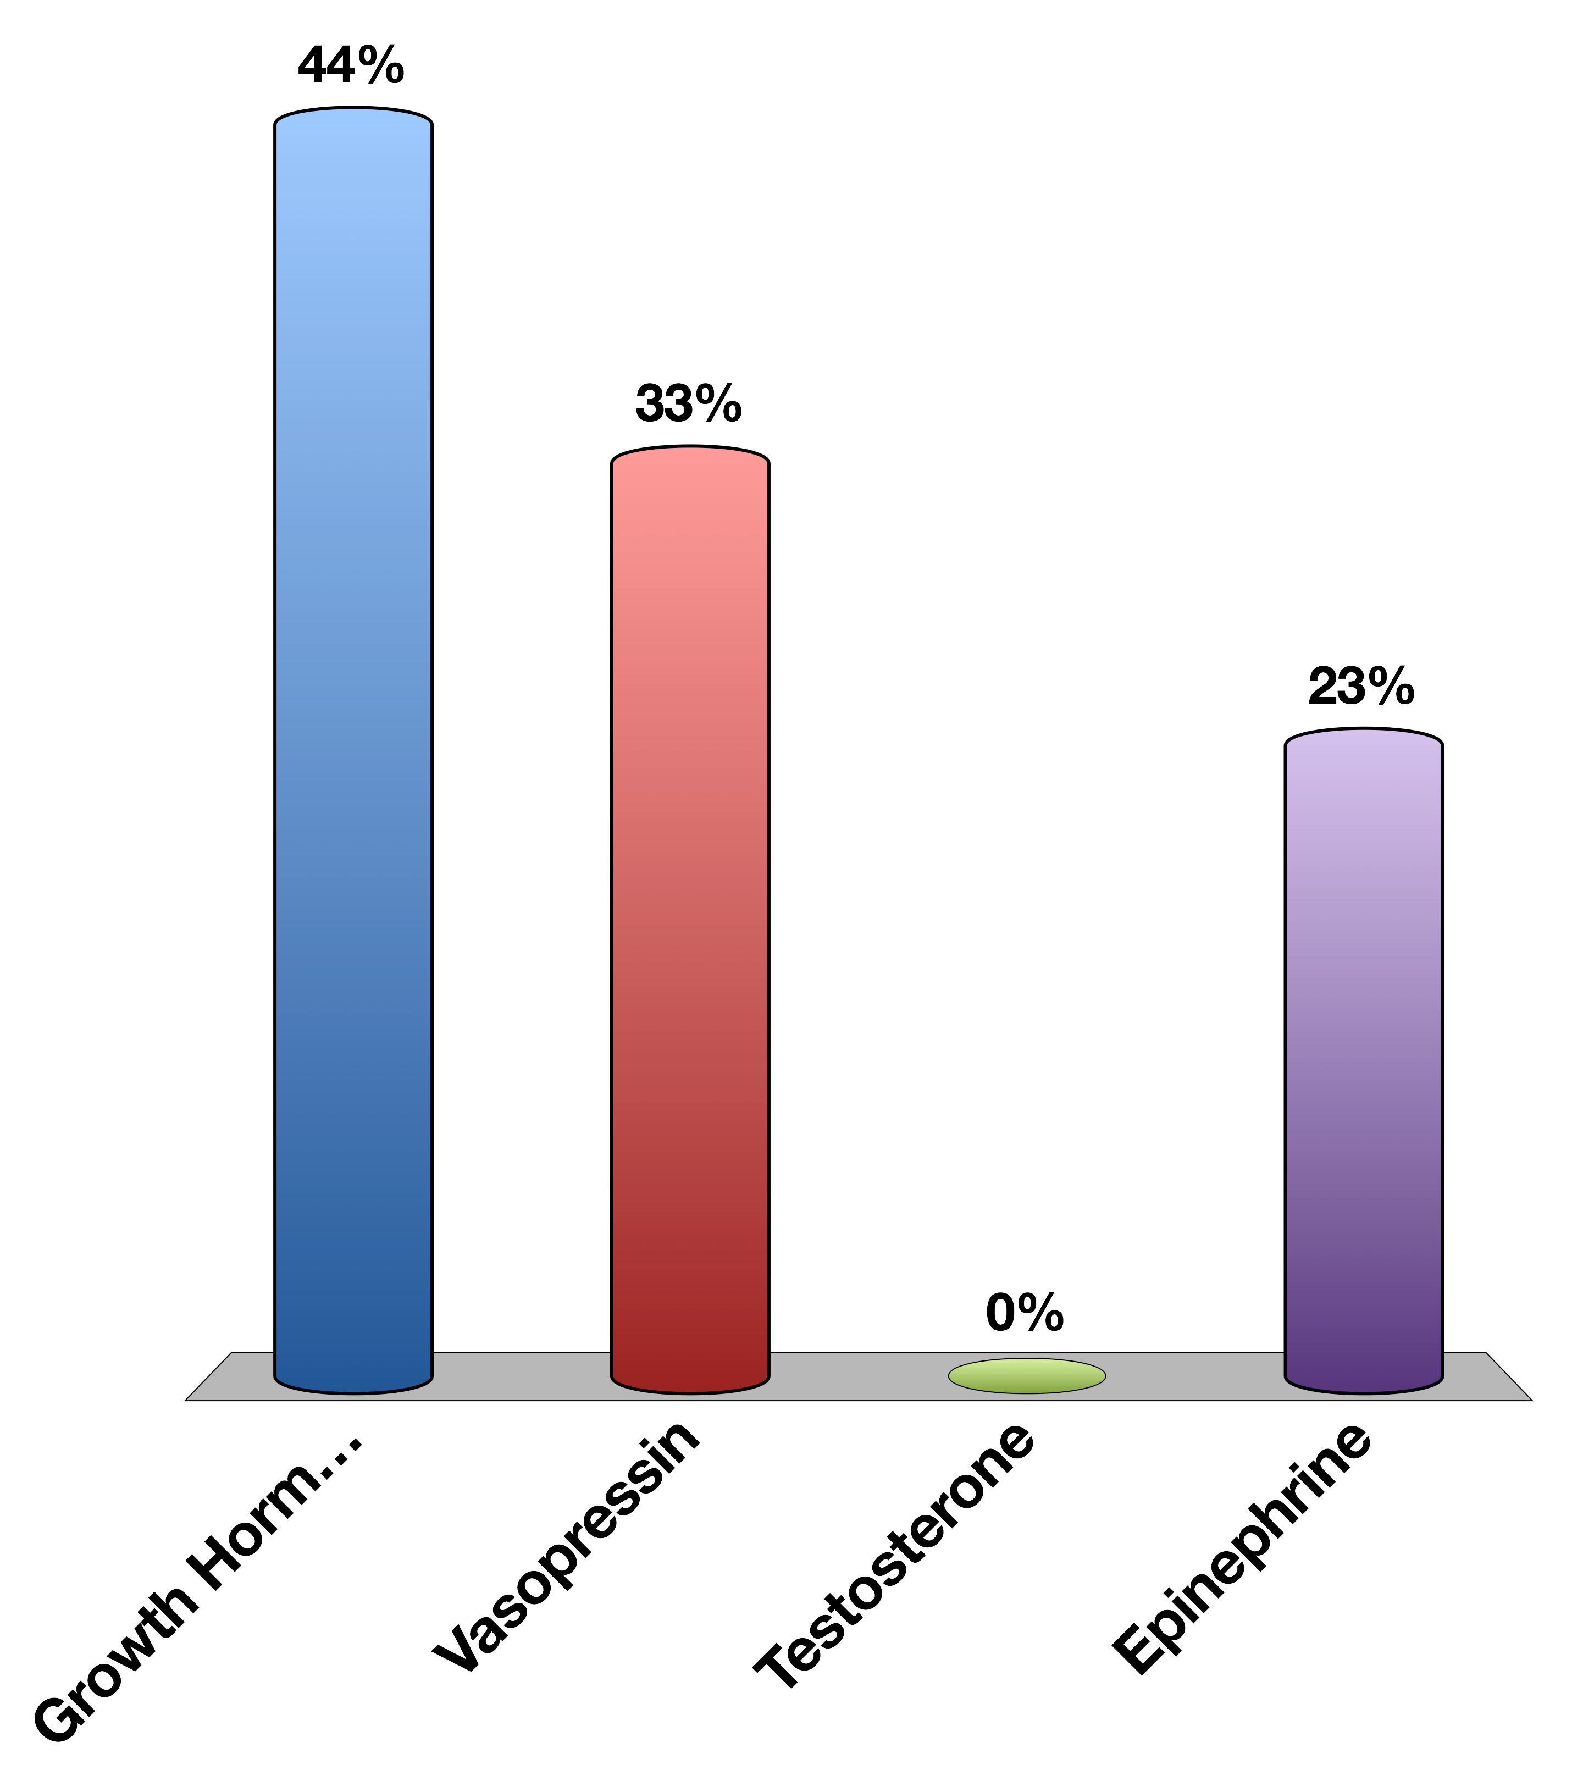
Which of the following is a peptide hormone
Growth Hormone
Vasopressin
Testosterone
Epinephrine
0

Slide 5
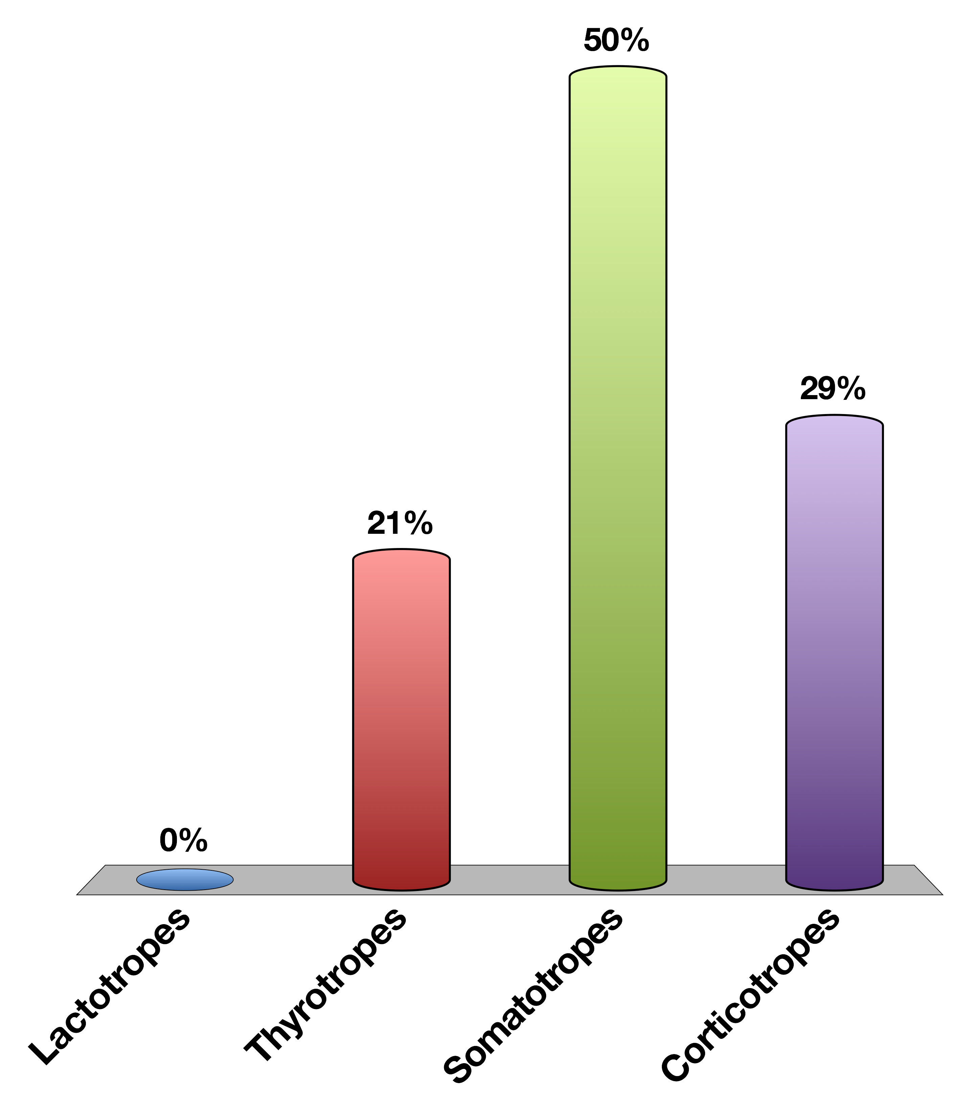
What Cell Type Secretes Growth Hormone
Lactotropes
Thyrotropes
Somatotropes
Corticotropes
0

Slide 6
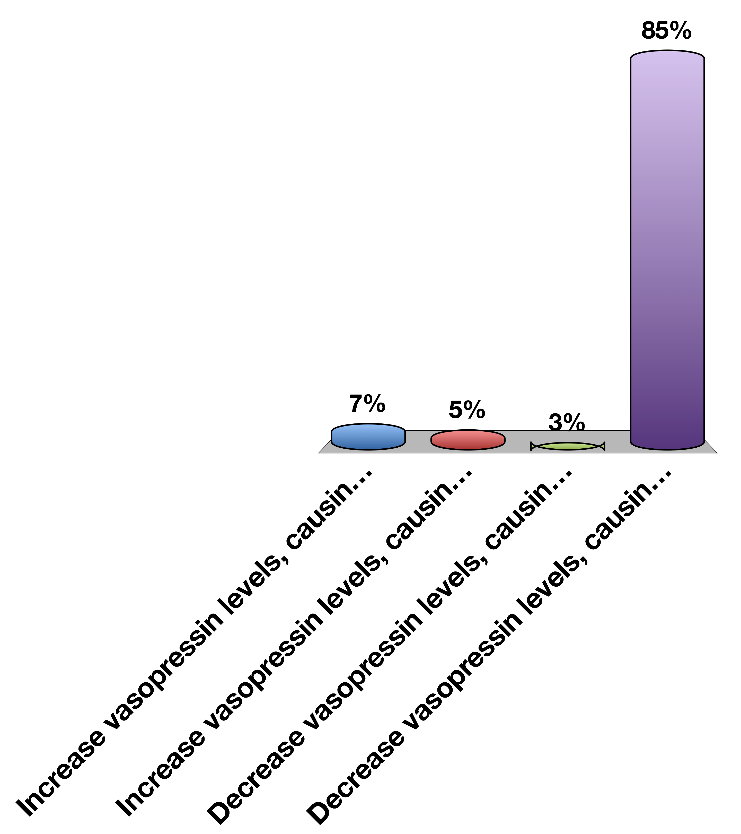
Drinking a lot of water will…
Increase vasopressin levels, causing water reuptake
Increase vasopressin levels, causing water excretion
Decrease vasopressin levels, causing water reuptake
Decrease vasopressin levels, causing water excretion
0

Slide 7
Adrenal Gland and Stress Hormones

Slide 8
Learning Objectives
Name three zones in the adrenal cortex and major regulator(s) of each zone.
Name three steroidogenesis pathways and their major products.
Explain briefly the physiological mechanism of adrenogenital syndrome.
Describe the physiological actions and roles of aldosterone.
Explain briefly the renin-angiotensin system.
Describe the negative feedback regulation of aldosterone and its relationship to blood volume/blood pressure homeostasis.
Describe hepatic and extrahepatic metabolic actions of glucocorticoids. Discuss their relationship.
State the major findings caused by adrenal hypersecretion of mineralocorticoids.
State the major findings caused by adrenal hypersecretion of glucocorticoids.
Name the major hormones secreted from the adrenal medulla. Discuss the differences of epinephrine (epi) and norepinephrine (NE) in cardiovascular actions (physiological levels).
List the major metabolic actions of catecholamines.
Contrast the thresholds for actions vs. plasma levels of epi and NE under common conditions, like exercise, and in the disease pheochromocytoma

Slide 9
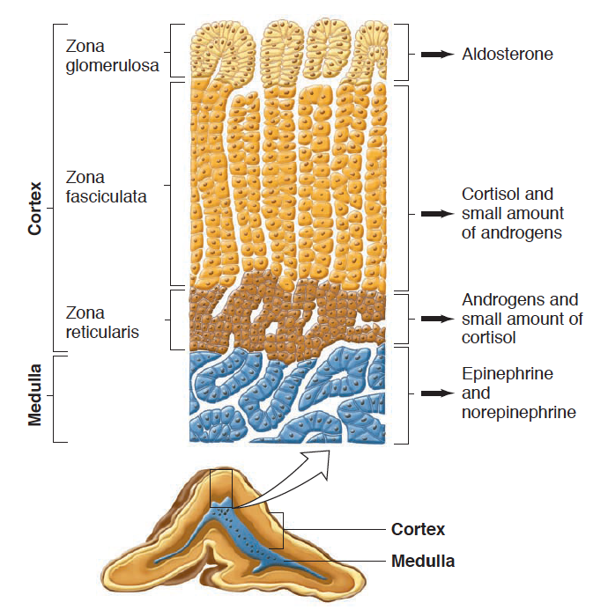
Adrenal Gland Anatomy
Notes:
Recall back to the anterior pituitary that there are specialized cell types that are hormone factories.
We are going to talk about the steroid hormones first, then the biogenic amines

Slide 10
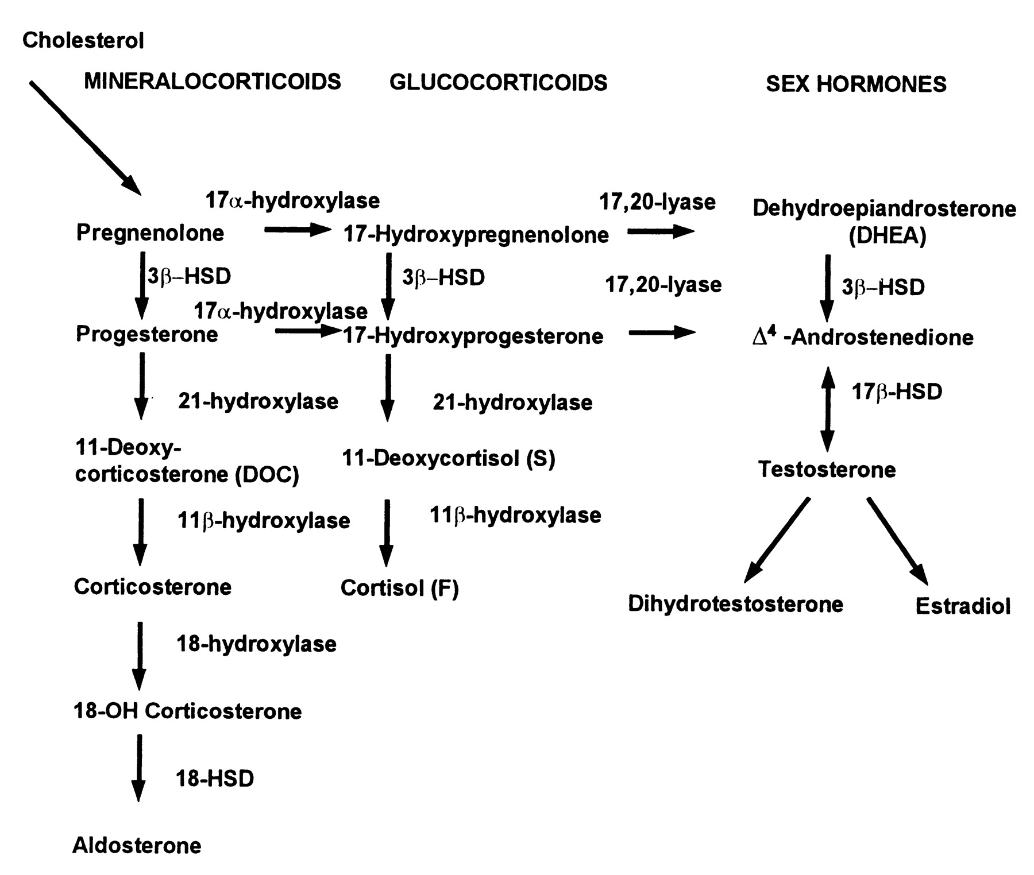
Steroid Hormone Biosynthesis
Maria I. New, and Robert C. Wilson PNAS 1999;96:12790-12797
Notes:
Don’t need to know these enzymes, but you do need to know there are three major pathways

Slide 11
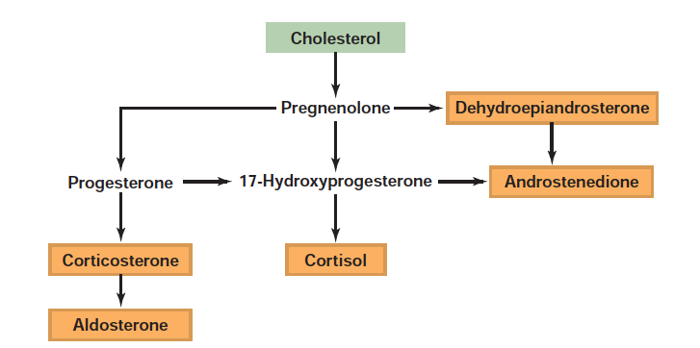
Steroid Hormone Synthesis

Slide 12
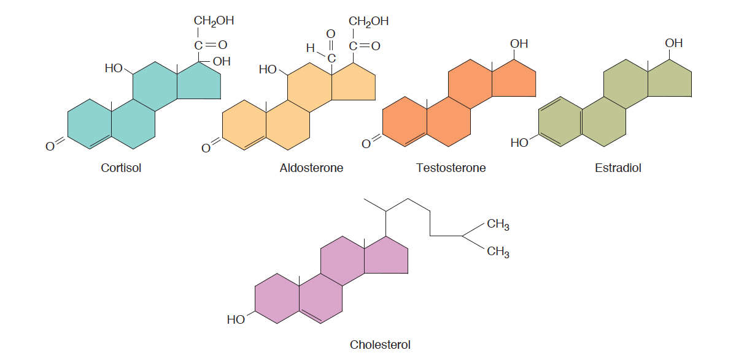
Steroid Hormones Released From Adrenal Medulla
Notes:
Note that cortisol and aldosterone have fairly similar structures

Slide 13
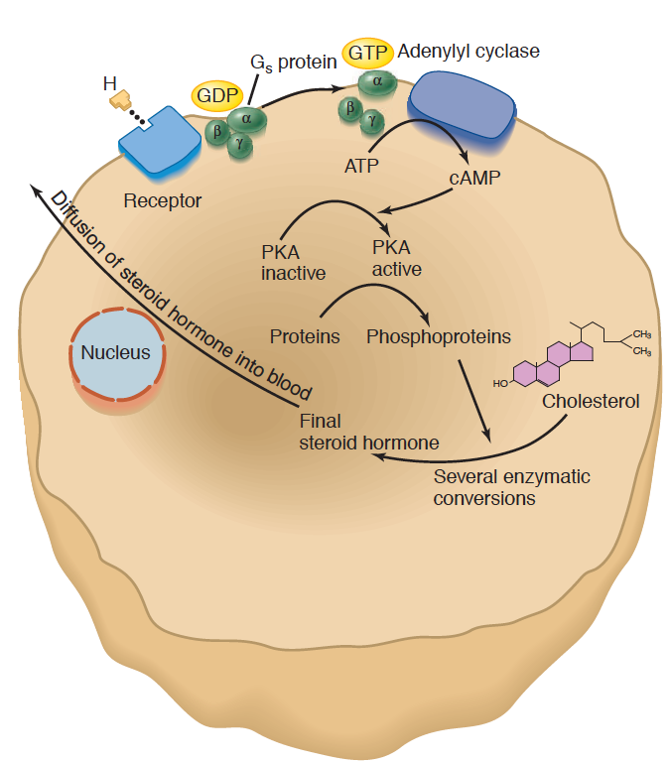
Adrenal Steroid Hormone Synthesis Mechanisms
Signal | Receptor | Hormone
ACTH | MC2R (GPCR - Gs) | Cortisol
Angiotensin II | AGTR1 (GPCR – Gq) | Aldosterone
Notes:
Regulated by increasing the synthesis of the relevant steroids, which are then passively released into the blood

Slide 14
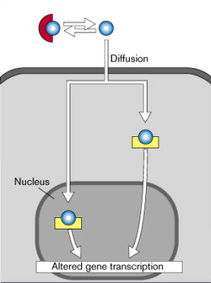
Both Aldosterone and Cortisol Function Through Nuclear Hormone Signaling

Slide 15
Aldosterone Regulates Mineral Balance

Slide 16
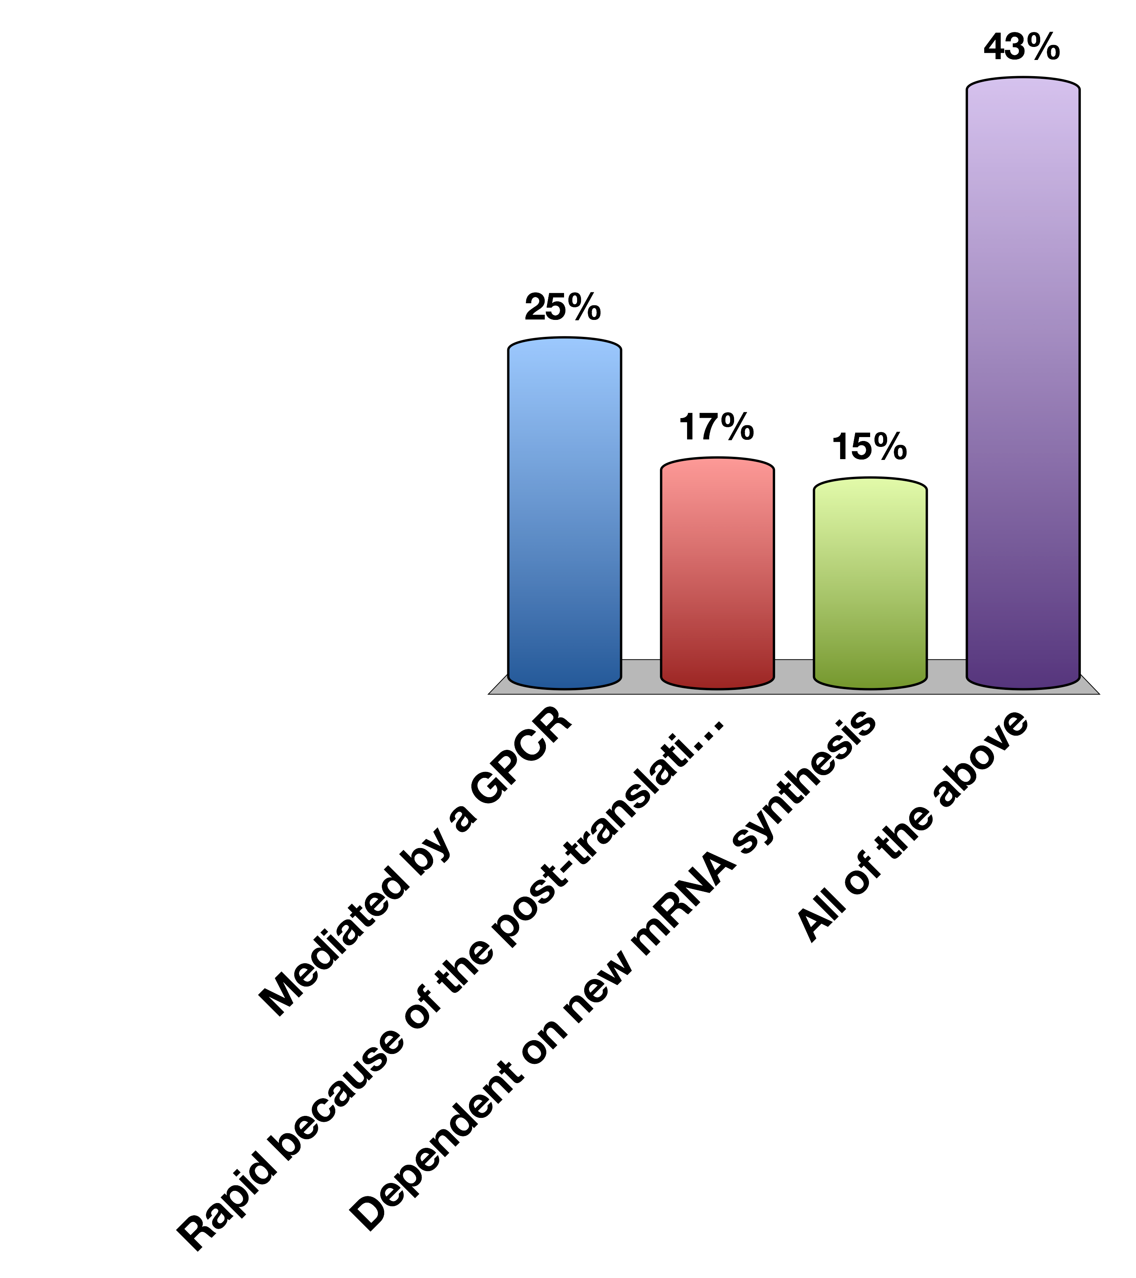
Direct Aldosterone Effects on Cells Are…
Mediated by a GPCR
Rapid because of the post-translational modification of enzymes
Dependent on new mRNA synthesis
All of the above
0

Slide 17
Aldosterone Summary
What chemical type | Steroid hormone
Where is it made? | Adrenal Cortex (Zona glomerulosa)
What causes its release? | Angiotensin II Signaling (GPCR –Gq) and to a lesser extent ACTH
What are its receptors? | Mineralcorticoid Receptor
What tissues does it affect? | Kidneys (Collecting Ducts and Distal Convoluted Tubule) | ENAc, Na/K Transporter/SGK
How does it get turned off? | Receptor desensitization, less ATII signaling, 11BHSD2

Slide 18
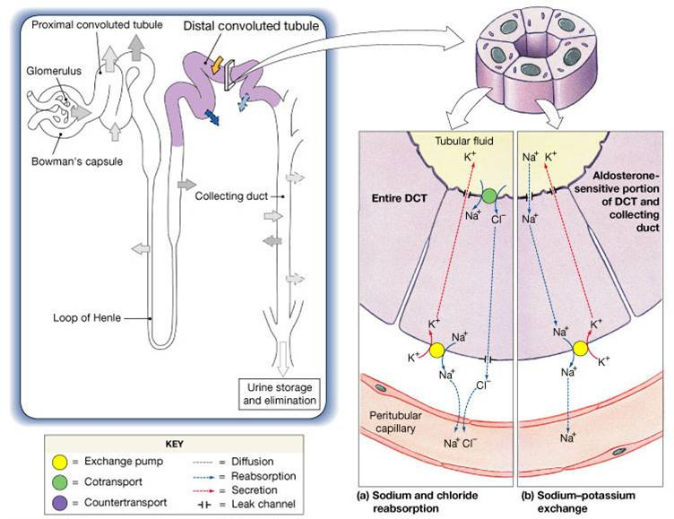
Key Aldosterone Effectors
ENac
Na/K
Notes:
Should be here at 15 minutes

Slide 19
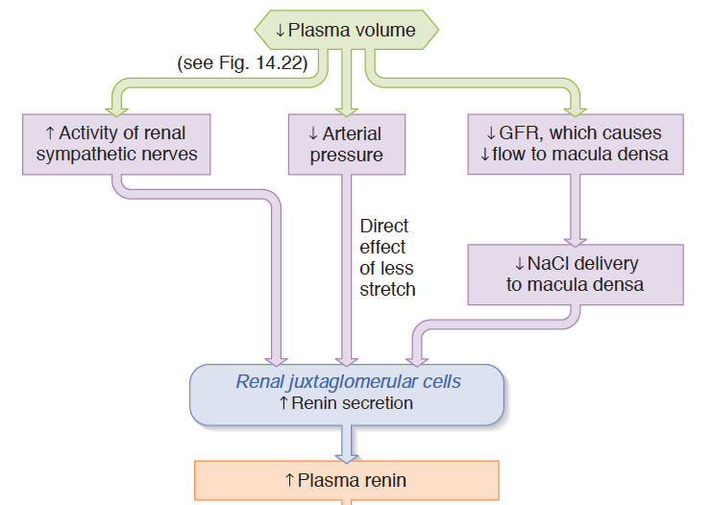
Renin as a Volume/Pressure Sensor
Notes:
Mechanotransduction and sympathetic activity

Slide 20
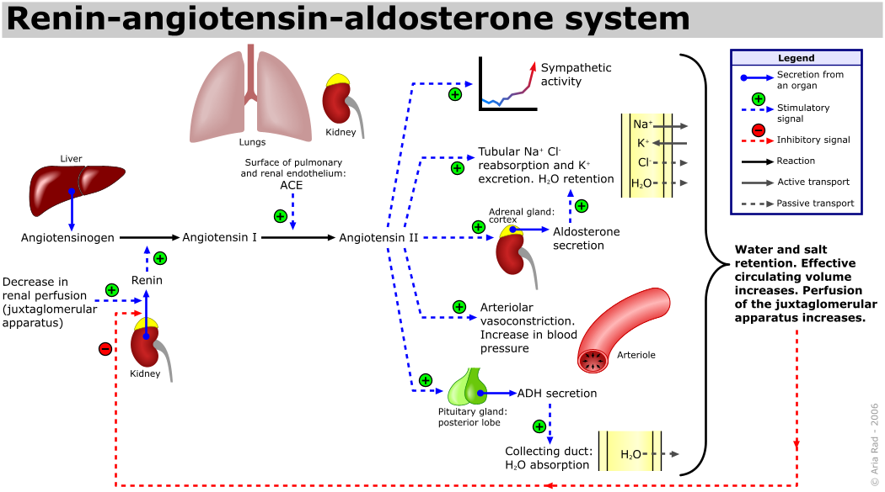
The Renin/Angiotensin System
Notes:
Point out the negative feedback occurs via sensing at the JG cell.
Quick effect via angiotensin, long term effect via aldosterone
Less stretch, less
This is separate to just the effects of vasopressin

Slide 21
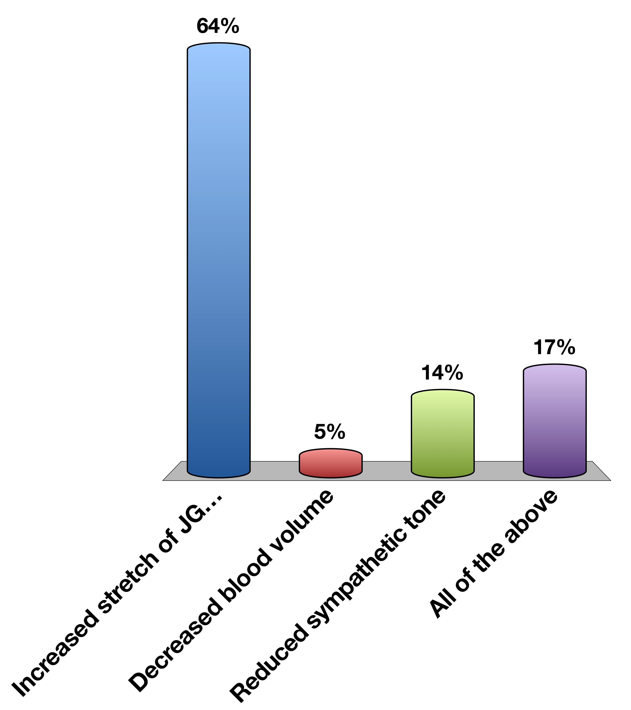
Renin Secretion is Stopped By
Increased stretch of JG cells
Decreased blood volume
Reduced sympathetic tone
All of the above
0

Slide 22
Stress Responsive Hormones

Slide 23

Two Types of Stress Response
Adrenaline
Cortisol
Notes:
Short term, need to get away from the snake
Chronically they are better prepared for a snake attack, energy is partitioned in away to be prepared for a snake attack, but long term normal functions such as growth, reproductive function and immunity are still suppressed

Slide 24
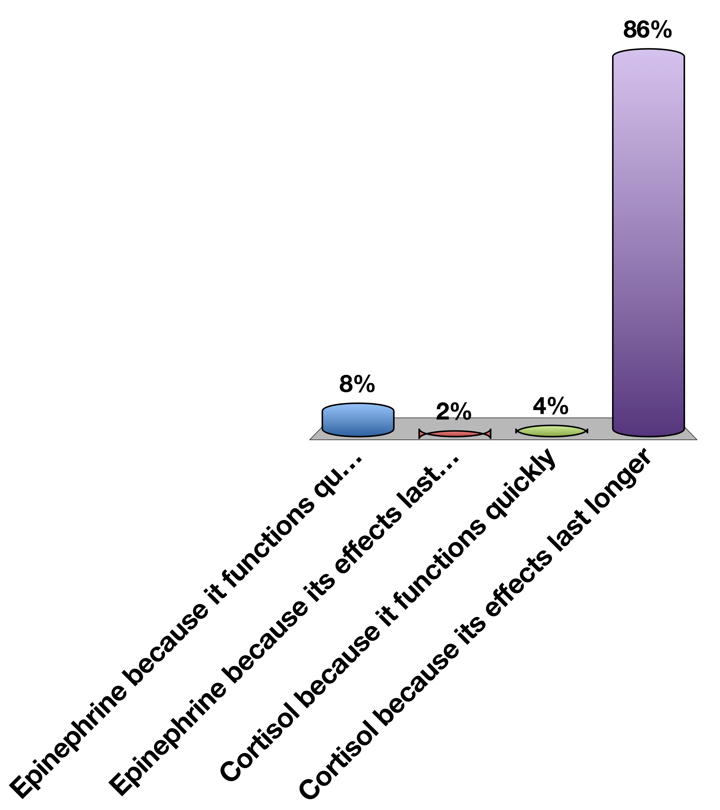
Which hormone should mediate chronic stress responses?
Epinephrine because it functions quickly
Epinephrine because its effects last longer
Cortisol because it functions quickly
Cortisol because its effects last longer
0

Slide 25
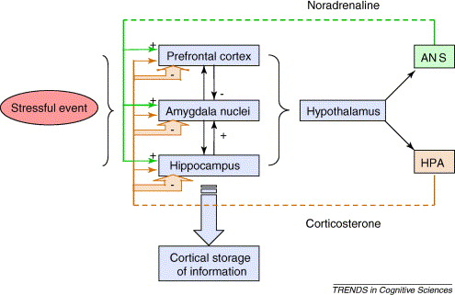
CRH Release

Slide 26
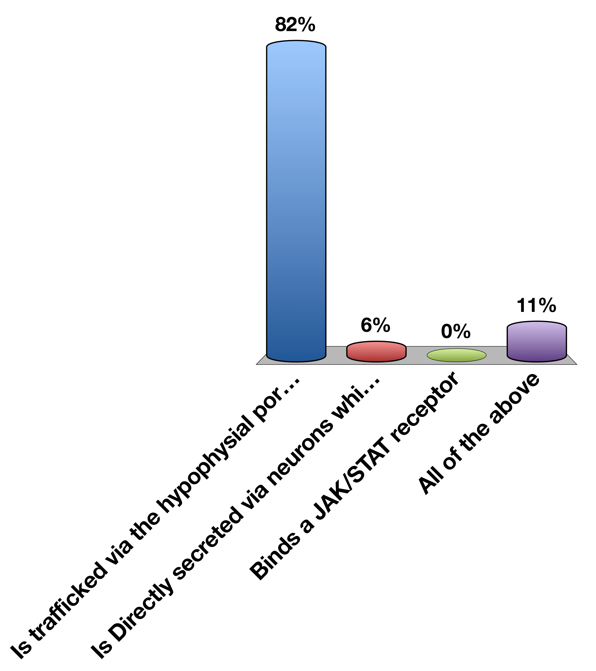
CRH is released from the hypothalamus to the anterior pituitary, so therefore…
Is trafficked via the hypophysial portal system
Is Directly secreted via neurons which pass through the infundibulum
Binds a JAK/STAT receptor
All of the above
0

Slide 27
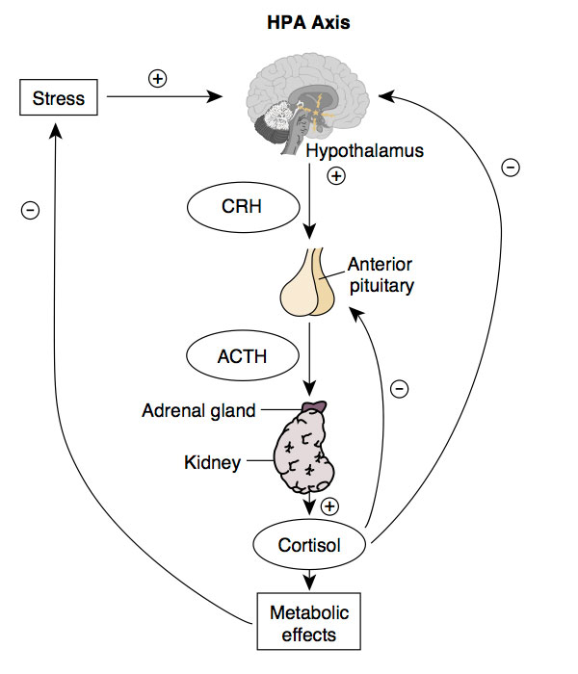
HPA Axis

Slide 28
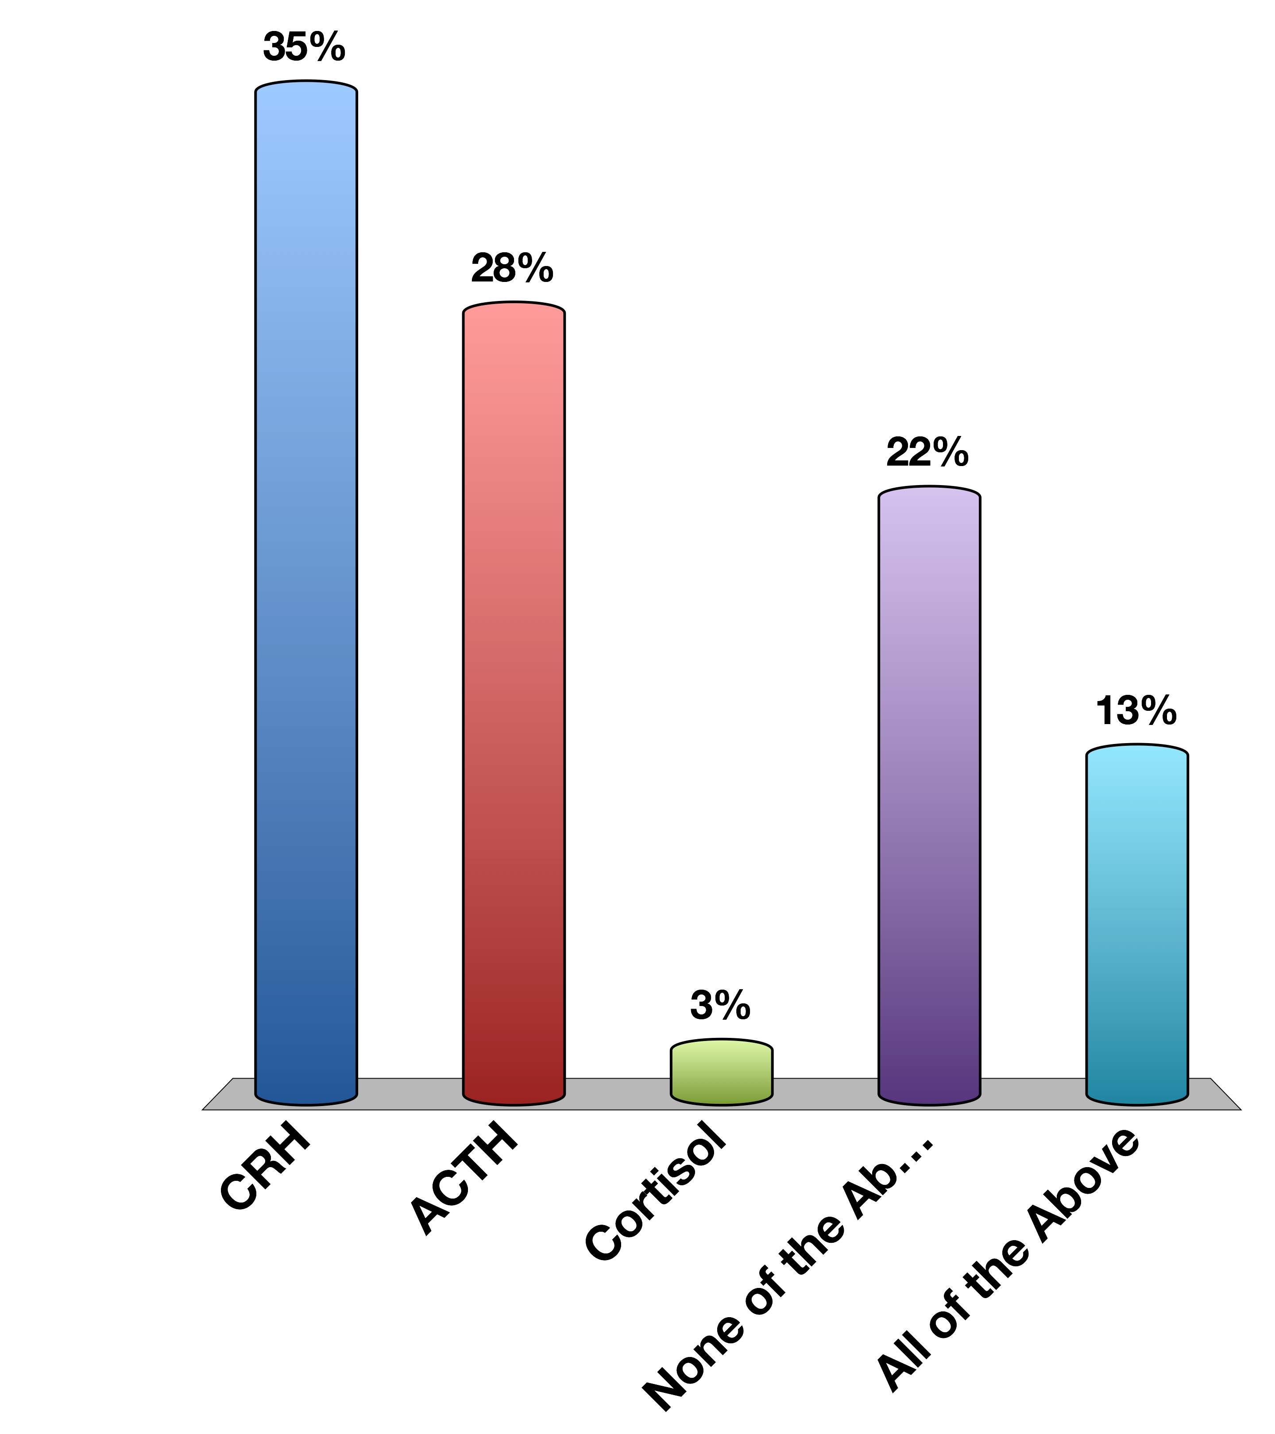
Which of these are directly released in a neuroendocrine manner?
CRH
ACTH
Cortisol
None of the Above
All of the Above
0

Slide 29
Corticotropin Releasing Hormone
Where is it made? | Hypothalamus (PVN)
What causes its release? | Stress (Synaptic Inputs)
What are its receptors? | CRHR1/2 (Gs)
What tissues does it affect? | Corticotropes in the Anterior Pituitary | ACTH Release
How does it get turned off? | Receptor desensitization, Cortisol Negative Feedback to Hypothalamus, 11BHSD2

Slide 30
ACTH
Where is it made? | Corticotropes of the Anterior Pituitary
What causes its release? | CRH into the hypophysial portal system
What are its receptors? | ACTHR (Gs - GPCR)
What tissues does it affect? | Adrenal Cortex | Cortisol synthesis
How does it get turned off? | Receptor desensitization, Cortisol Negative Feedback to Hypothalamus, Cortisol Negative Feedback to Hypothalamus 11BHSD2

Slide 31
Cortisol Summary
Where is it made? | Adrenal Cortex (Zona fasciculata)
What causes its release? | ACTH (GPCR –Gs)
What are its receptors? | Glucocorticoid Receptor
What tissues does it affect? | Muscle | Protein Catabolism
 | Adipose | Increased Lipolysis, Adipogenesis
 | Liver | Increased Gluconeogenesis
 | Brain | Less Food Intake
 | Immune System | Reduced Th2 Activation
How does it get turned off? | Receptor desensitization, Negative Feedback to Pituitary, Negative Feedback to Hypothalamus, 11BHSD2

Slide 32
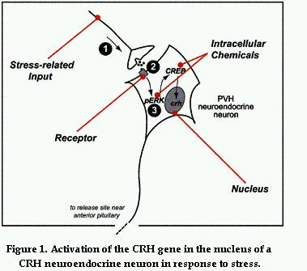
CRH In Response to Stress

Slide 33
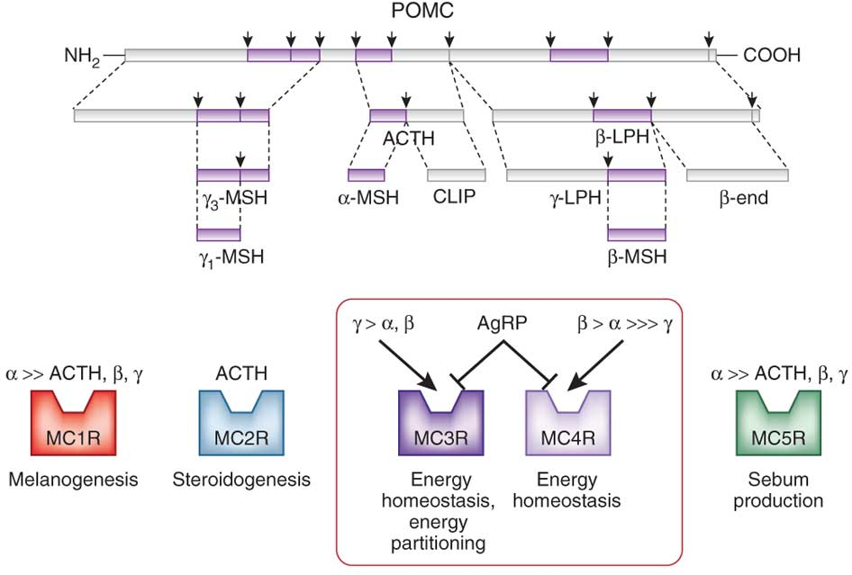
ACTH and other Hormones are Generated from POMC Transcripts

Slide 34
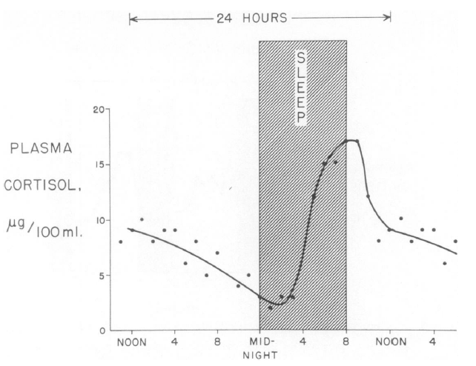
Daily Rhythms of Cortisol Release
Liddle GW (1966) An analysis of circadian rhythms in human adrenocortical secretory activity. Trans Am Clin Clim Assoc 77: 151–160.
Notes:
Related to this, prolonged fasts also elevate cortisol levels

Slide 35
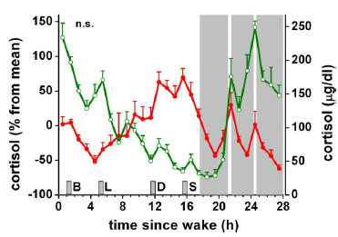
Night Time Workers
Normal
Sleep disrupted
Scheer F AJL, Hilton MF, Mantzoros CS, Shea S A (2009) Adverse metabolic and cardiovascular consequences of circadian misalignment. Proc Natl Acad Sci U S A 106: 4453–4458. doi:10.1073/pnas.0808180106.
Notes:
Fedex workers

Slide 36
Major Chronic Responses to Stress
Shift resources (mainly glucose) towards essential functions
Suppress non-essential functions
Immune system
Reproductive system
Growth
Notes:
Should be here at 25 minutes

Slide 37
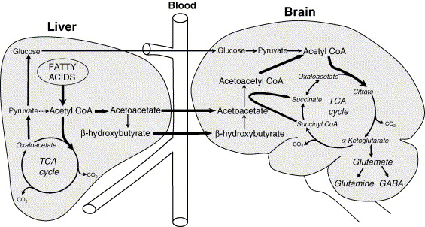
Brain Requires Glucose Supply
Notes:
Dosent store glycogen, limited gluconeogenic capacity
Glucose is produced by a process called gluconeogenesis

Slide 38
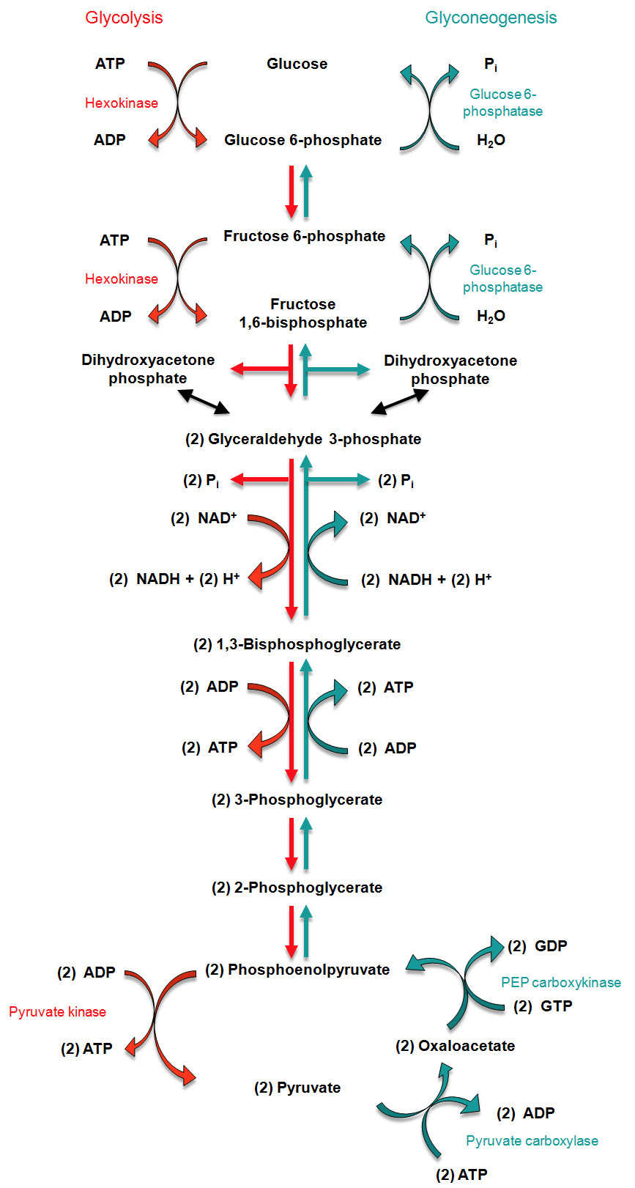
Regulation of Gluconeogenesis
Activation of mRNA transcription
by glucocorticoids in the liver
Notes:
Don’t need to know this, but the flow is going this way. The rate limiting steps are in blue

Slide 39
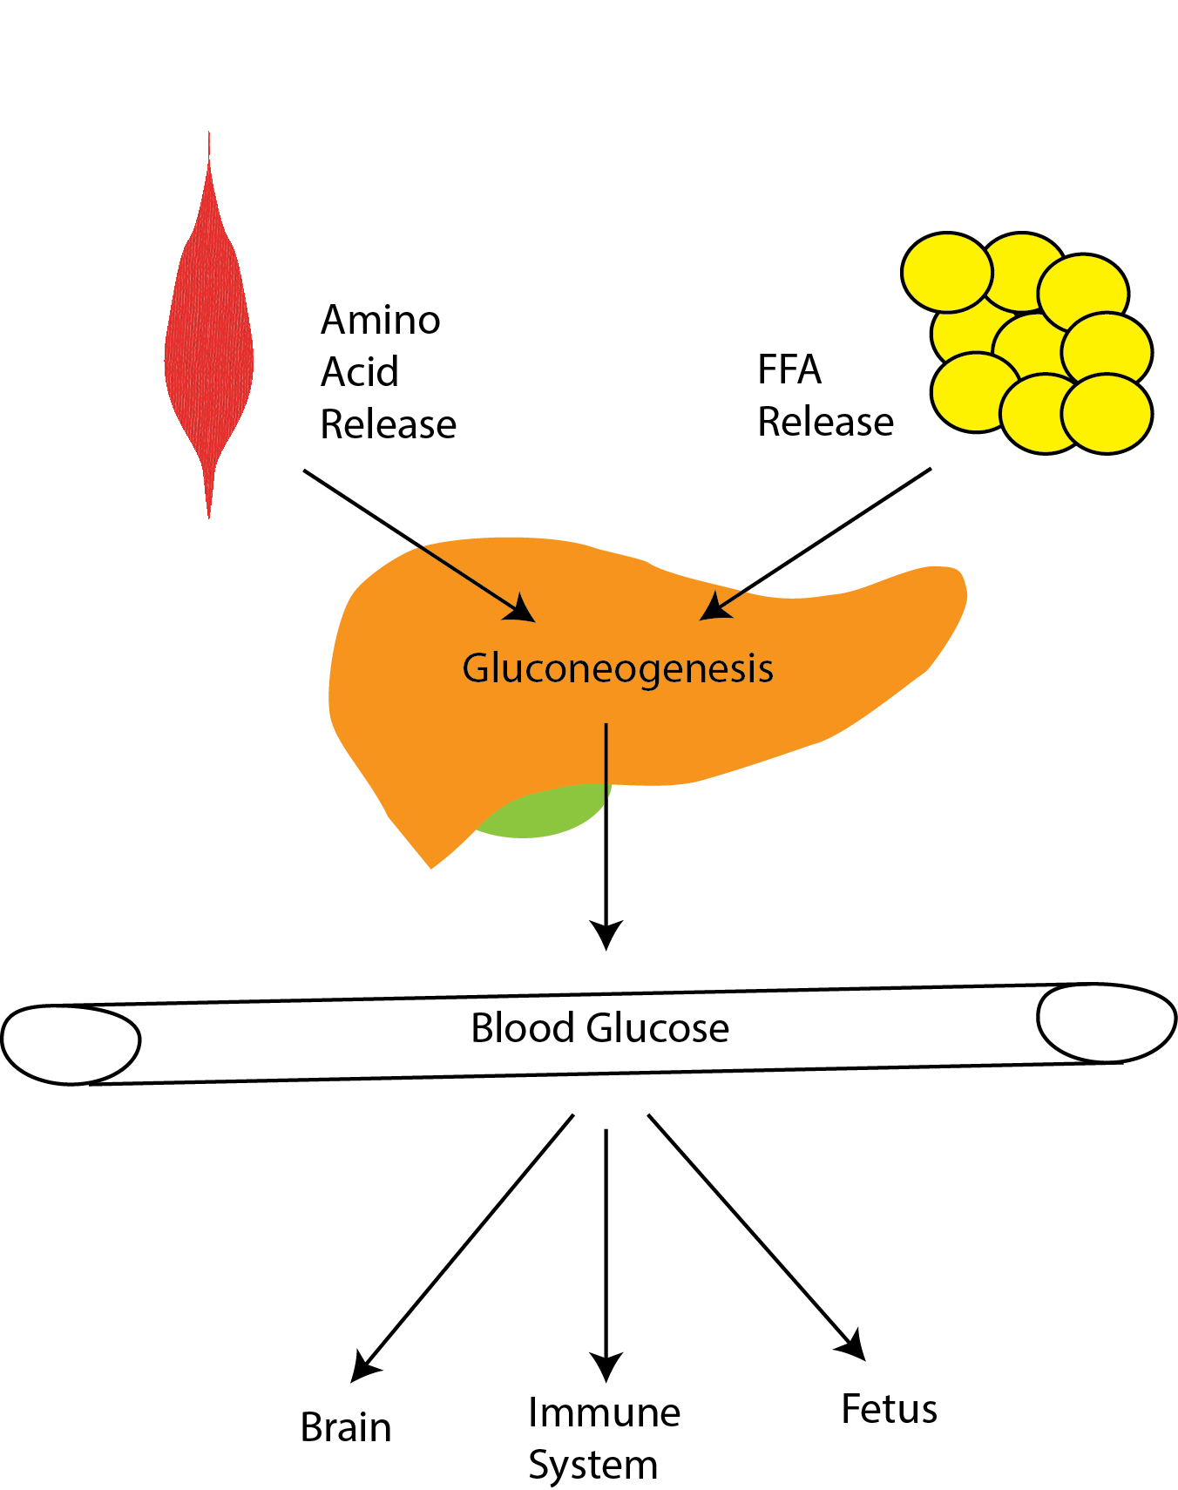
Cortisol Maintains Blood Glucose Levels
Notes:
Induces gluconeogenesis
Induces protein/triglyceride breakdown
Promotes insulin resistance

Slide 40
Three Mechanisms to Maintain Blood Glucose Levels
Promote gluconeogenesis (liver)
Provide substrates for gluconeogenesis (muscle/fat)
Prevent glucose uptake (muscle/fat)

Slide 41
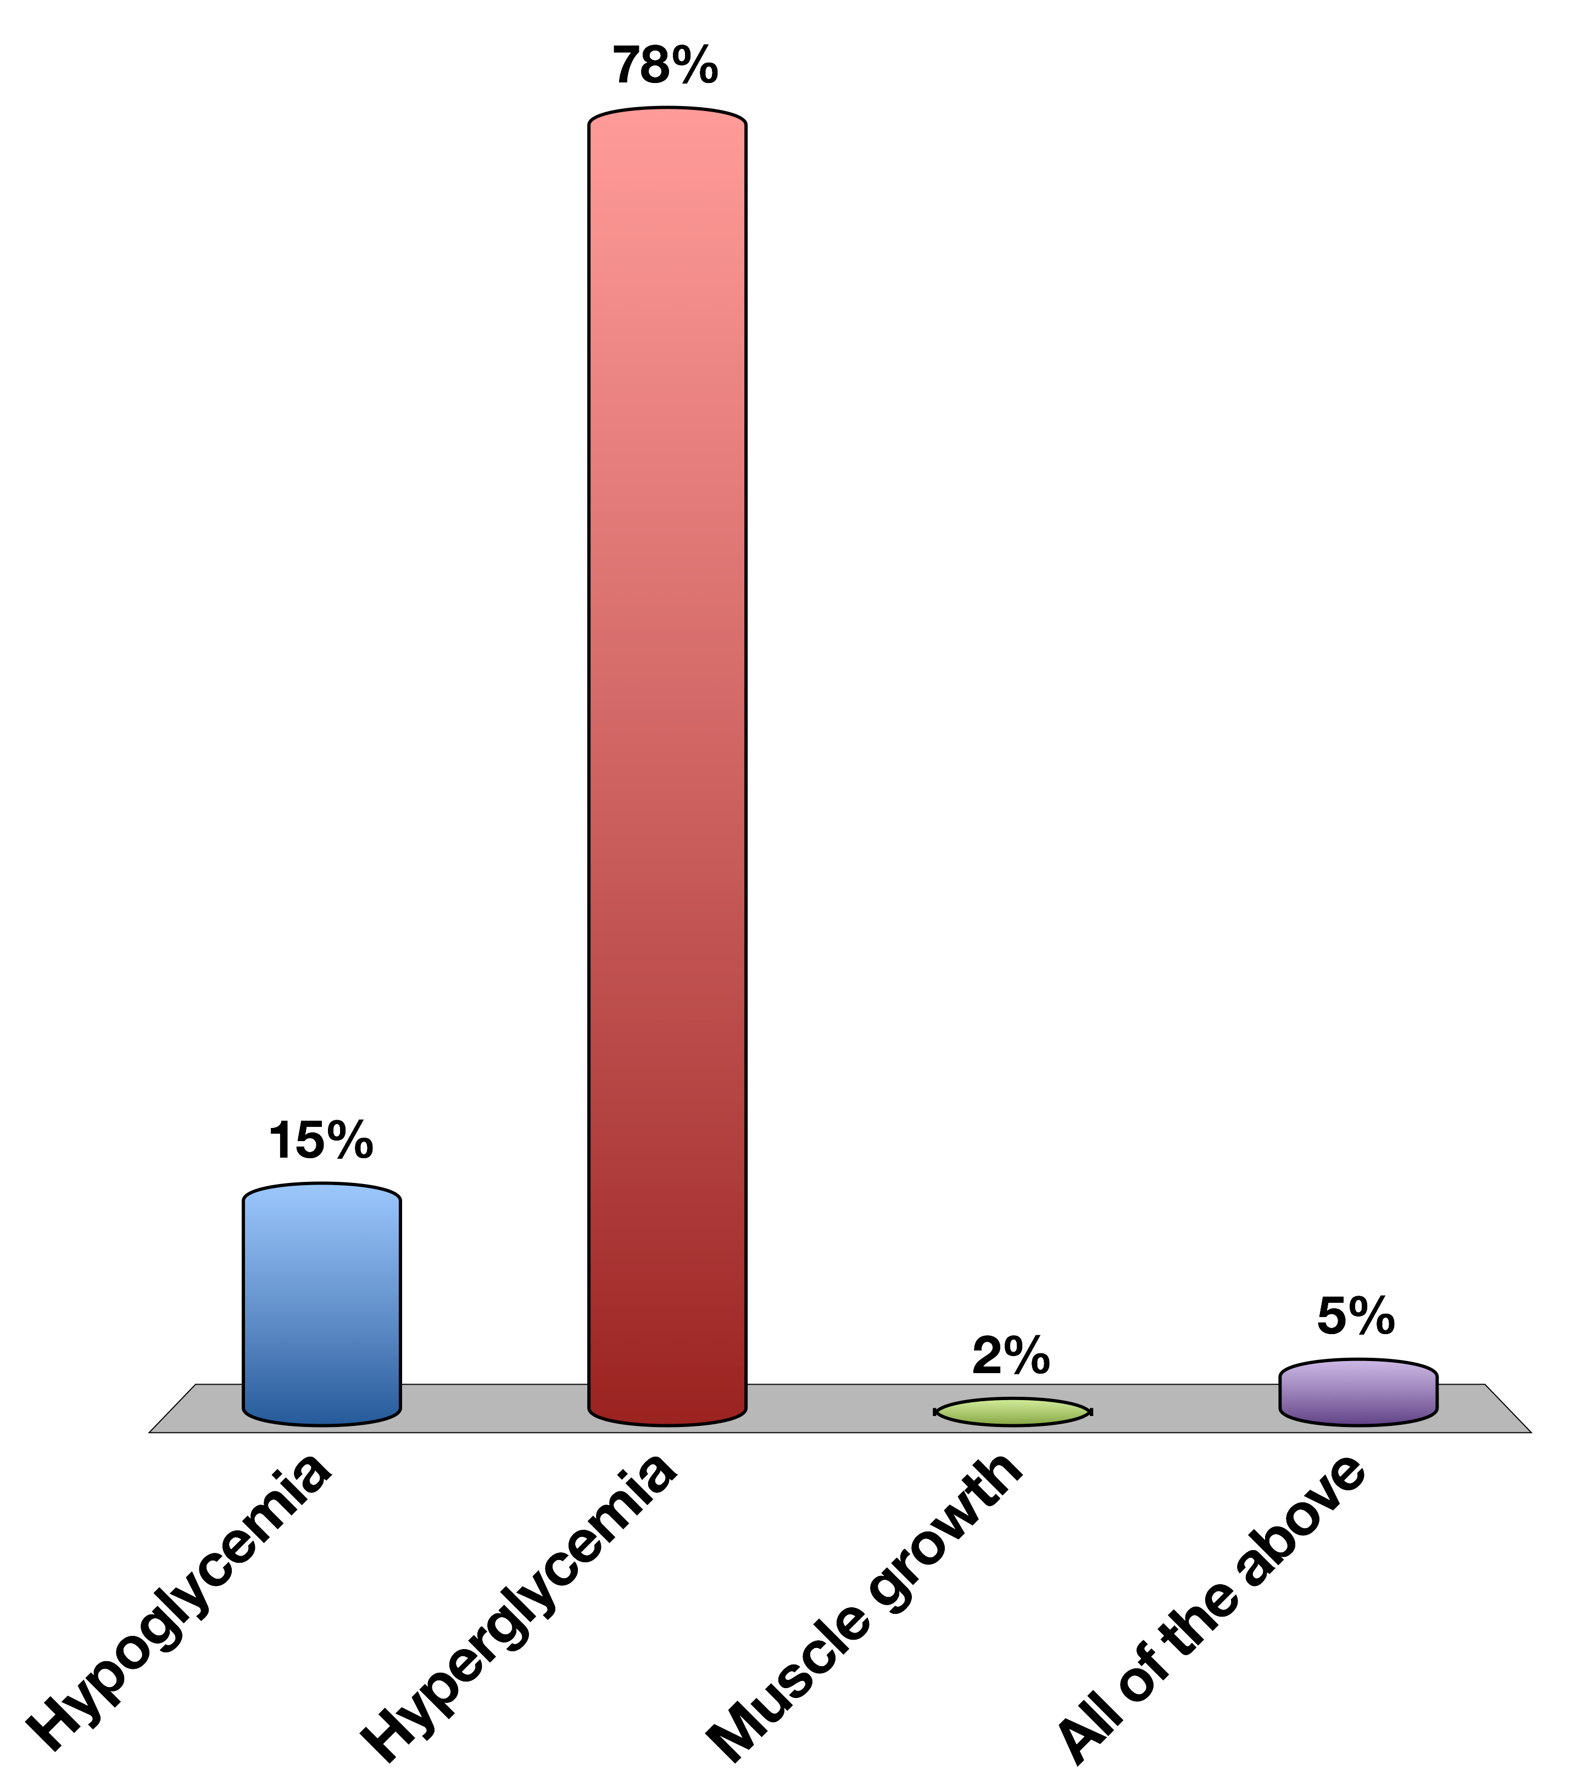
Chronically elevated glucocorticoid signaling would cause
Hypoglycemia
Hyperglycemia
Muscle growth
All of the above
0

Slide 42
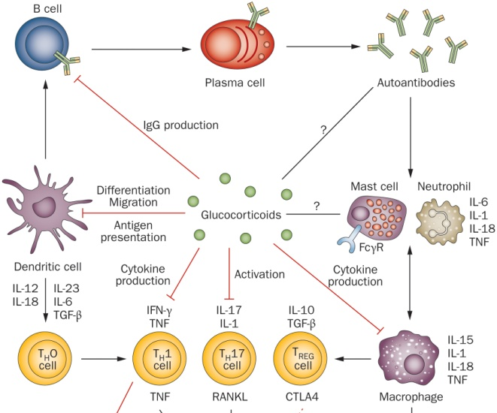
Effects of Cortisol on Immune Function
Notes:
Differentiation of precursors into differentiated immune cells, in both the innate and adaptive immune system

Slide 43
HPA Axis

Slide 44
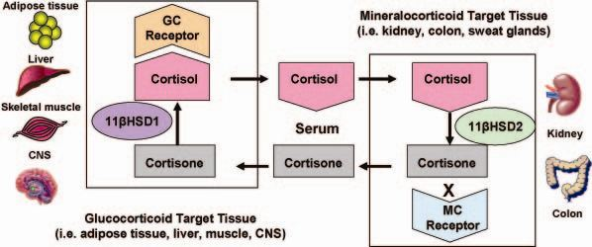
11β-HSD 2 and Local Concentrations of Glucocorticoids
In off target tissues,
or to desensitize normal tissues
Notes:
Problem is that cant restrict steroid hormones from getting into the cells, in the way that you can not express insulin receptors to prevent insulin action
This system accomplishes two things:
Since there is some weak effects of cortisol on the MC receptor this is a way to ensure no abberant MC signaling in the wrong tissues
Secondly this is a way for a tissue to locally control levels are part of a negative feedback mechanism

Slide 45
Adrenal Steroid Hormone Disfunction

Slide 46
Main Types of Endocrine Disfunction
Congenital (Mutations in Hormone Production or Responses)
Tumors which secrete too much hormone
Immune destruction of hormone secreting cells

Slide 47
Common CAH Mutations
Maria I. New, and Robert C. Wilson PNAS 1999;96:12790-12797
Notes:
90% are 21-hydroxylase
Effects of CAH on sex steroids
Smaller number are

Slide 48
Discuss
Congenital Adrenal Hyperplasia (aka adrenogenital syndrome)
Imagine mutations in genes involved early in the biosynthesis of cortisol/aldosterone
What would be the effects on
Sex hormone production
Salt balance
Adrenal size

Slide 49
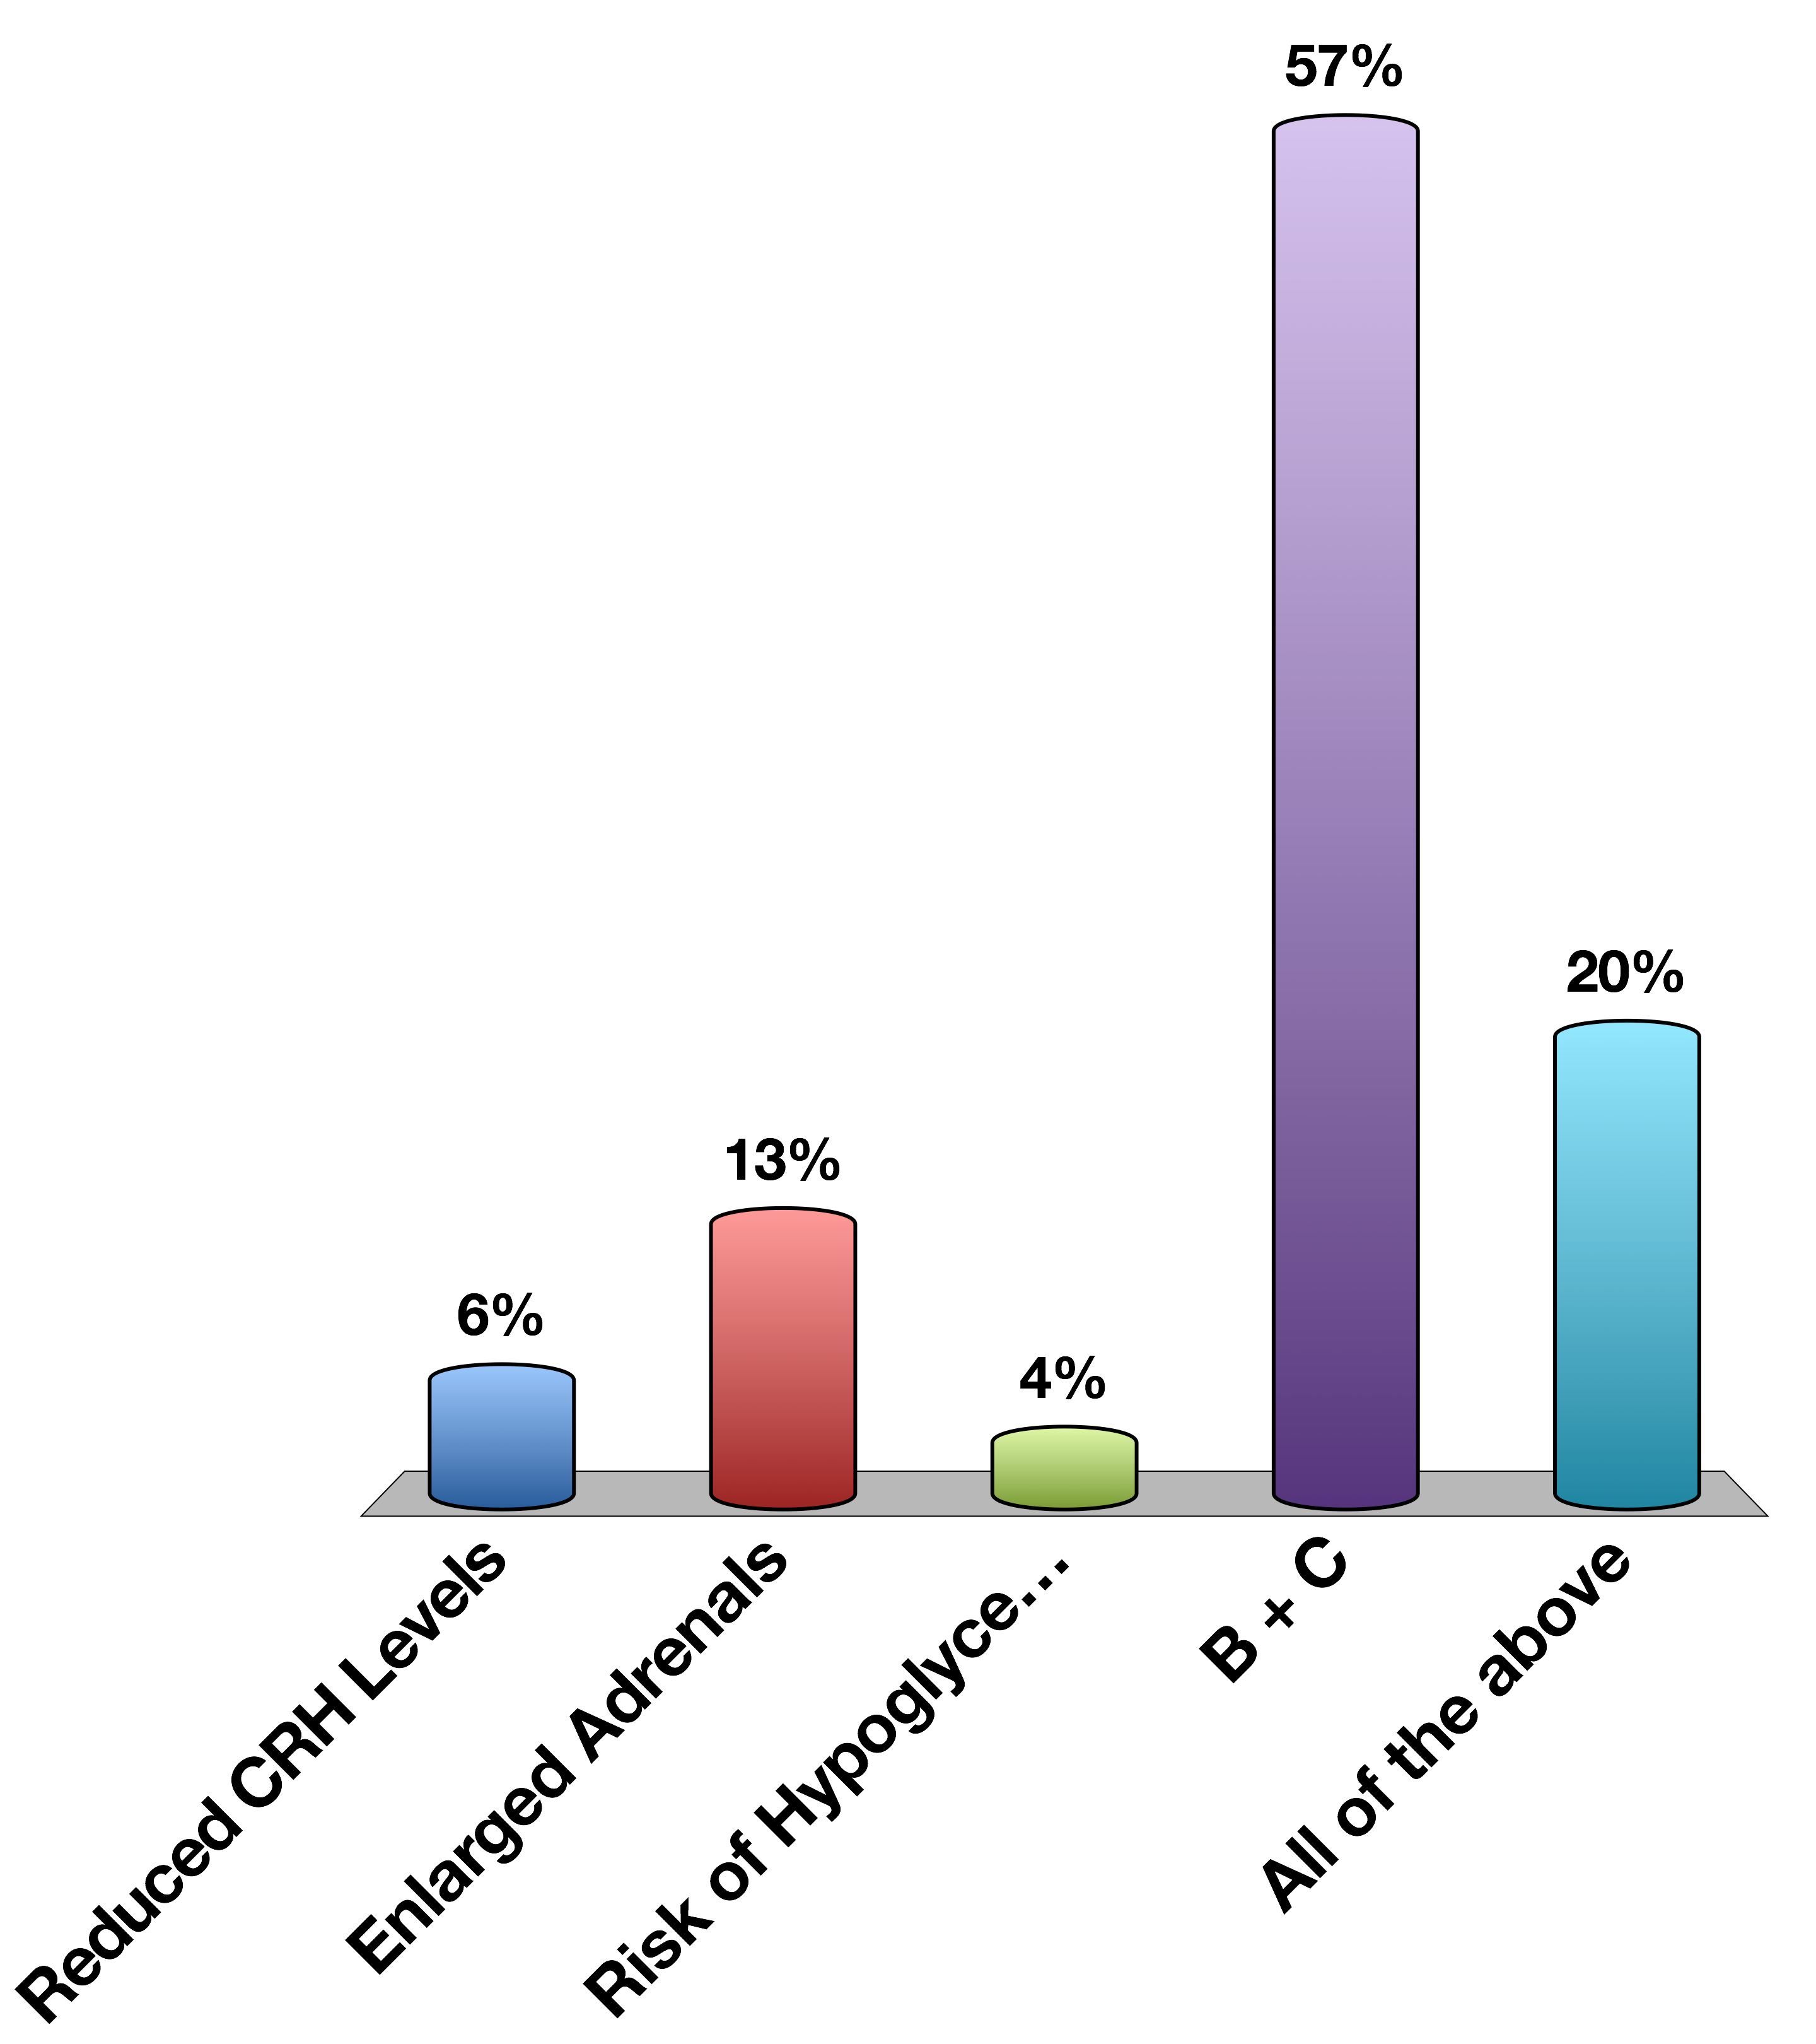
A Patient with a type of CAH that can not make Cortisol Would be Expected to have…
Reduced CRH Levels
Enlarged Adrenals
Risk of Hypoglycemia
B + C
All of the above
0

Slide 50
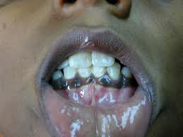
Addison’s Disease
Autoimmune destruction of adrenal gland
How would this anatomically differ from CAH?
Why would blood pressure be low?
Why would there be a risk of hypoglycemia?
Notes:
Hyperpigmentation is due to constant release of ACTH/MSH which are both part of POMC. This is because of reduced negative feedback of Cortisol onto the ACTH releasing cells/

Slide 51
Hyperpigmentation in Addison’s
Hyperpigmentation

Slide 52
Tumors Affecting Adrenal Function
Conn’s syndrome (adenoma of zona glomerulosa)
Cushing’s syndrome
pituitary adenoma (ACTH releasing) or
adenoma of zona fasciculata
Notes:
Talk about how tumors can cause release of extra hormones and why
If not running late, spend some time thinking up some of the symptoms of these syndromes

Slide 53
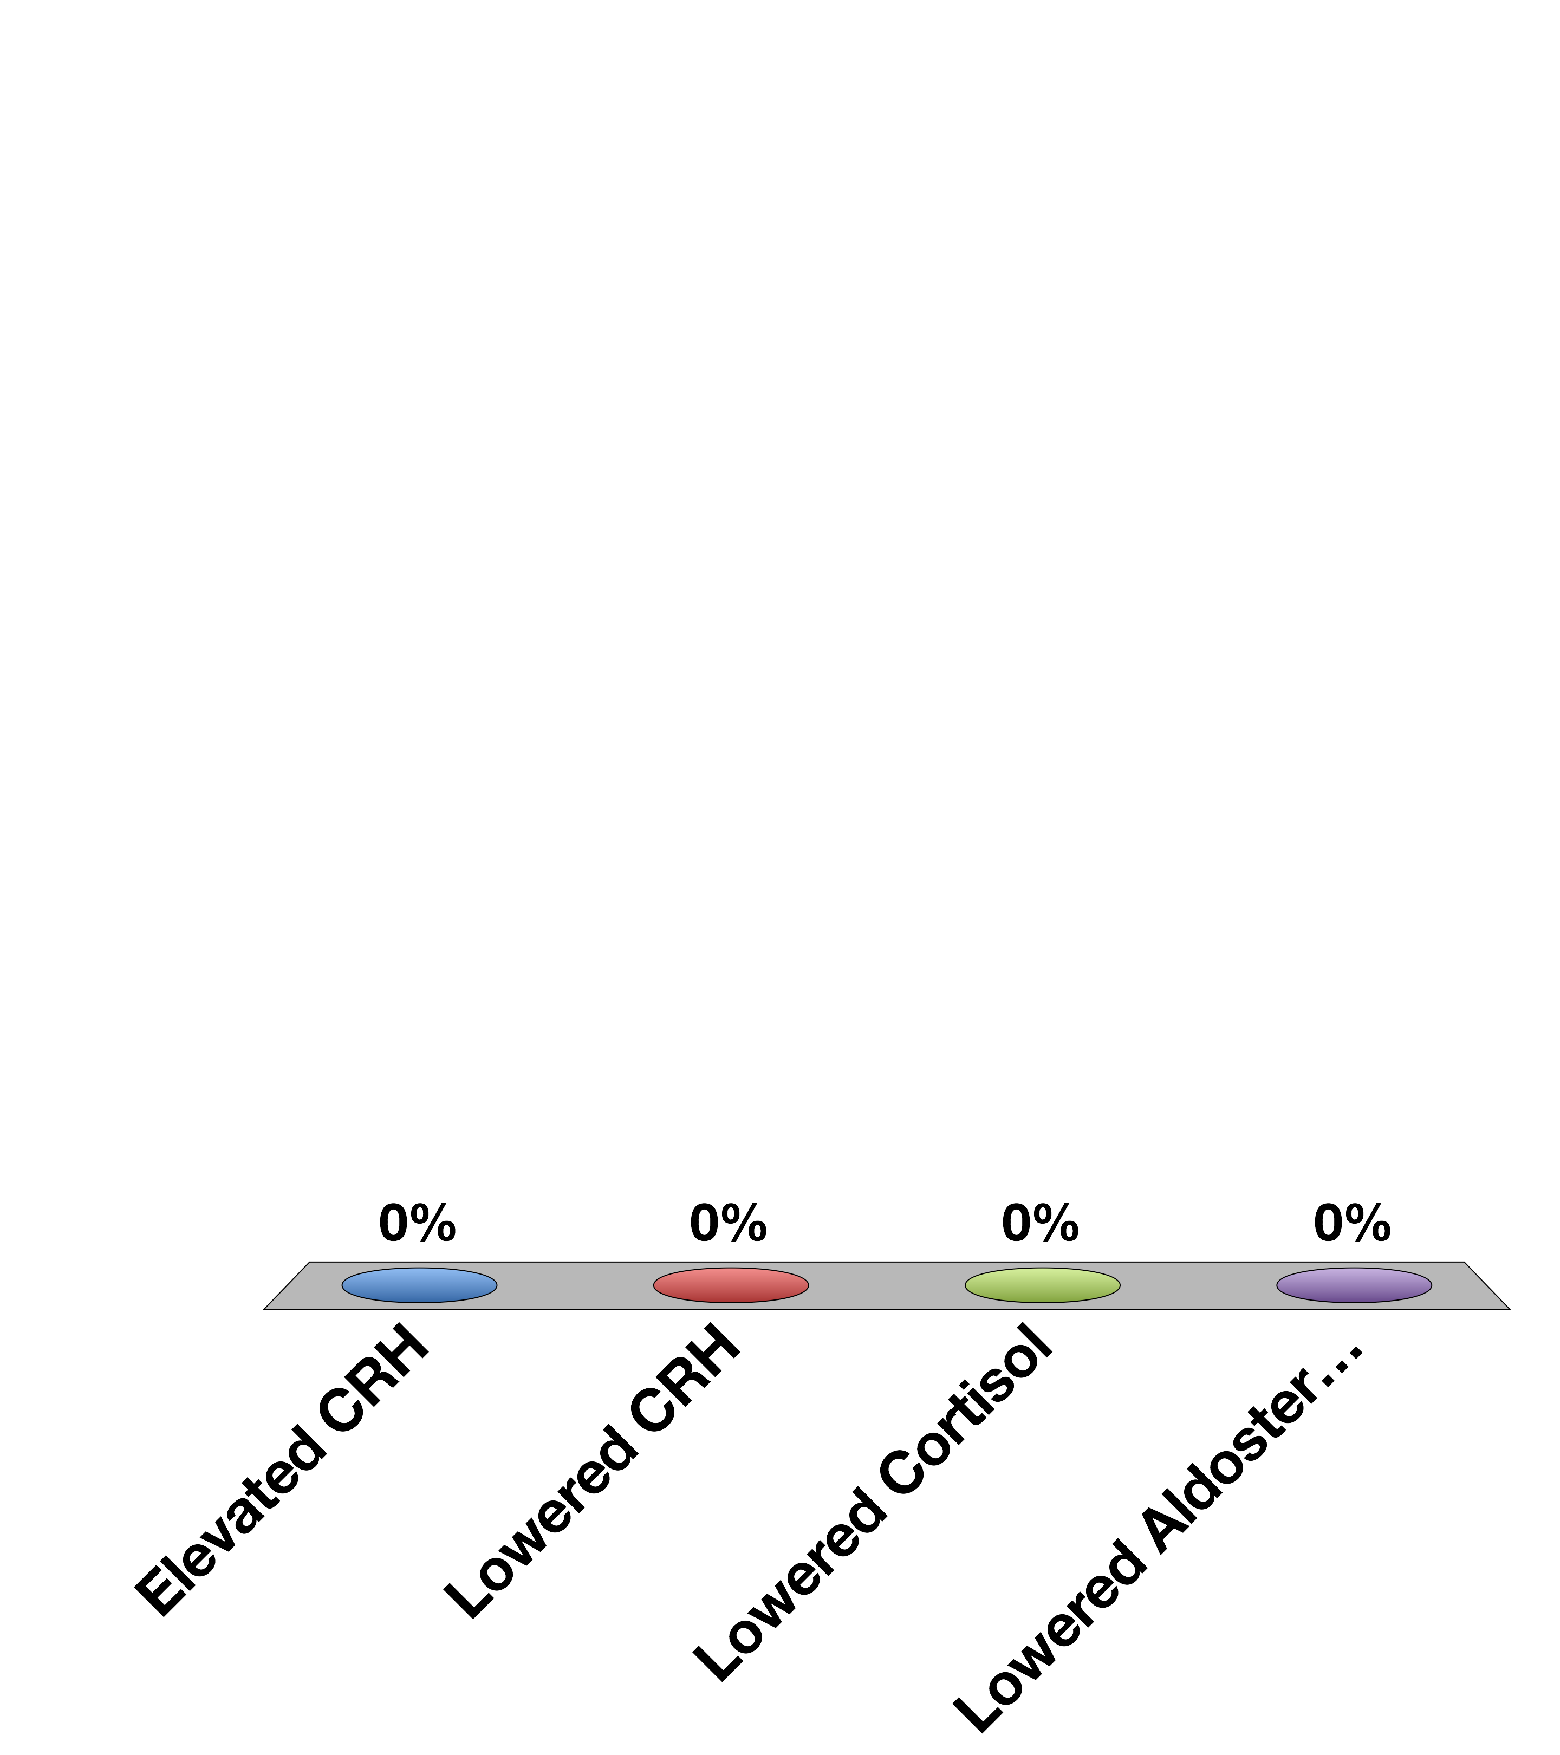
Cushing’s Syndrome (ACTH overproducing tumors) have
Elevated CRH
Lowered CRH
Lowered Cortisol
Lowered Aldosterone
30

Slide 54
Adrenaline Mediates Short-Term Stress Responses
Notes:
Should be here at 40 mins

Slide 55
Epinephrine Summary
Where is it made? | Adrenal medulla
What causes its release? | Sympathetic nervous stimulation
What is its receptor? | Alpha/Beta-Adrenergic Receptors (5 subtypes) | GPCR -> Gs and Gi
What tissues does it affect? | Heart | Increased heart rate
 | Lungs | Increased respiration
 | Vasculature | Vasoconstriction (smooth muscle), vasodilation (skeletal muscle)
 | Liver | Glycogenolysis
 | Fat | Lipolysis
 | Skeletal Muscle | Contraction
How does it get turned off? | Sympathetic signal stops, Receptor desensitization

Slide 56
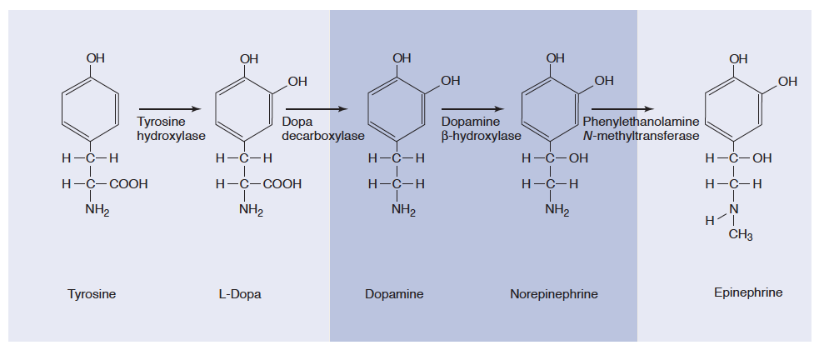
Epinephrine and Norepinephrine
Notes:
Adrenal medulla has high levels of PNMT

Slide 57
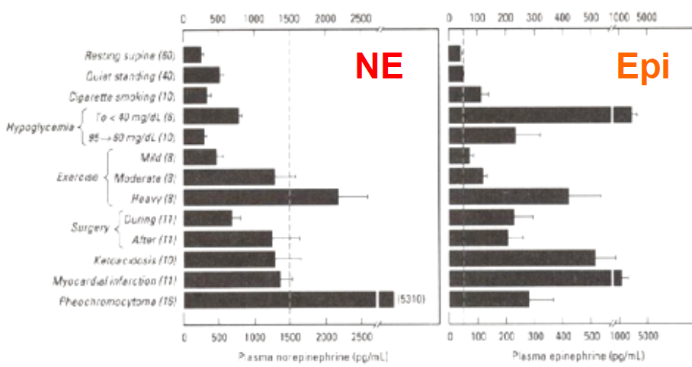
Epinephrine vs Norepinephrine
Dashed line is level in circulation needed to elicit a physiological response

Slide 58
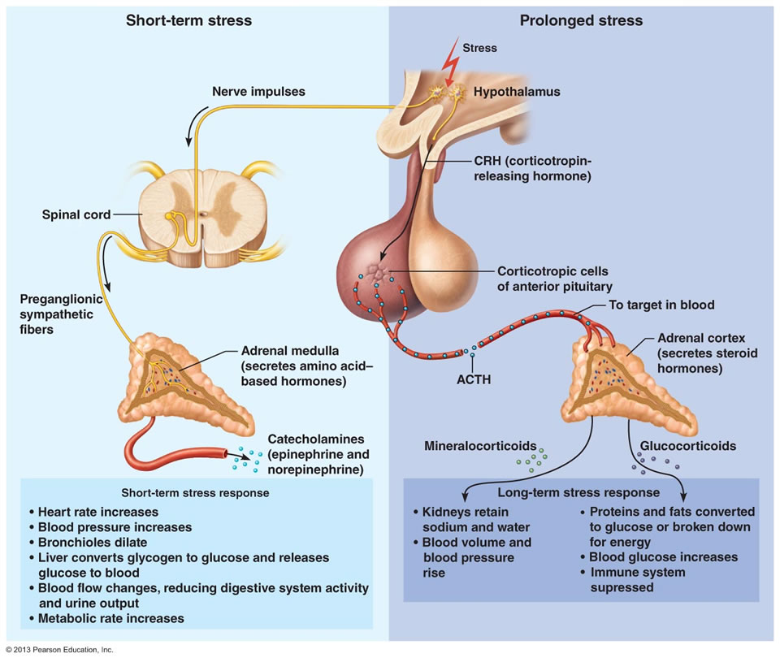
Adrenaline vs Cortisol Release

Slide 59
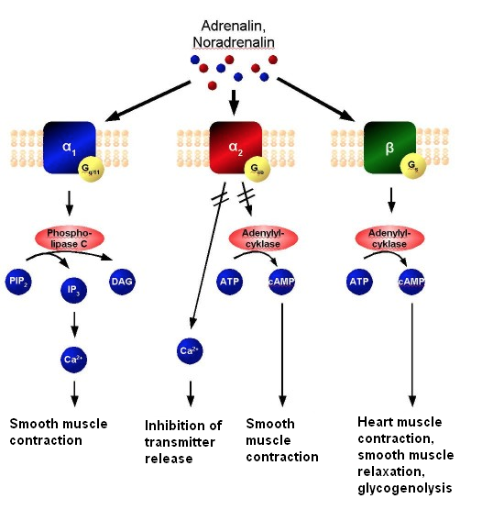
Cardiovascular Roles of Epinephrine
Gq
Gi
Gs
Notes:
Gi/Gq vasoconstriction
Gs vasodilation and heart muscle contraciton

Slide 60
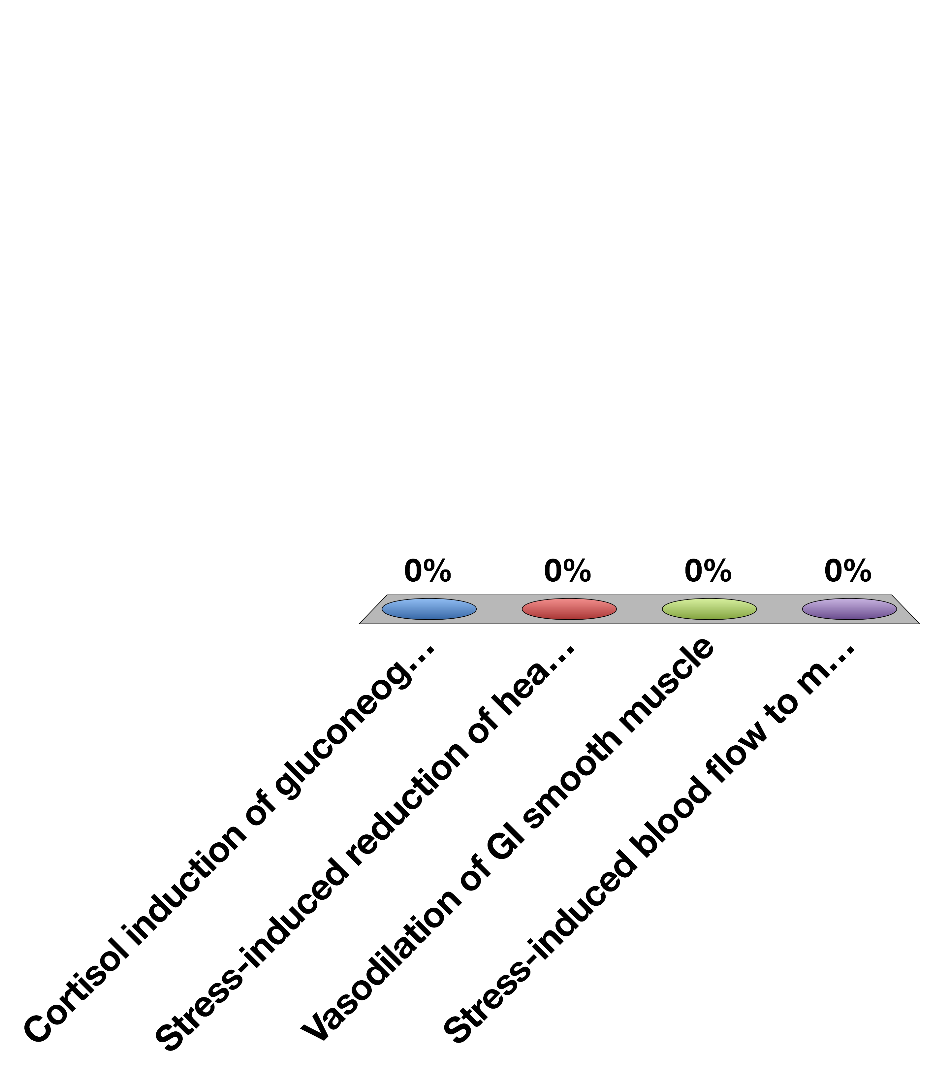
What would a beta blocker prevent?
Cortisol induction of gluconeogenesis
Stress-induced reduction of heart rate
Vasodilation of GI smooth muscle
Stress-induced blood flow to muscle
30

Slide 61
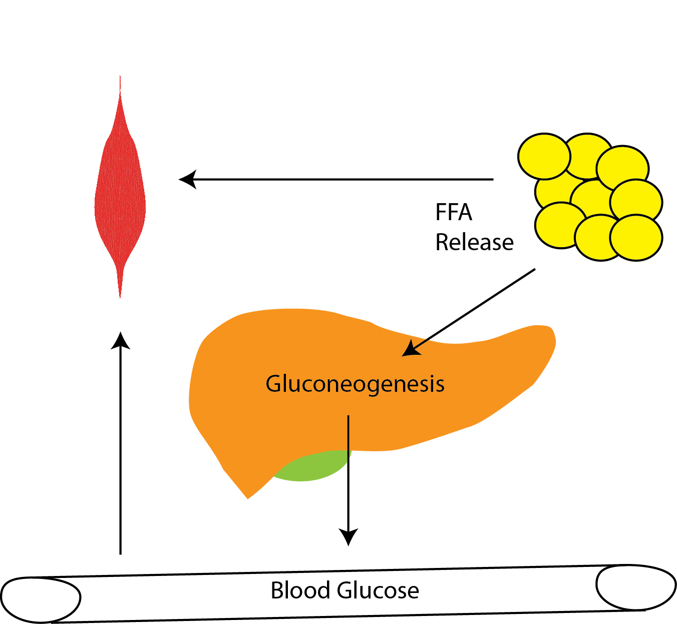
Metabolic Roles of Epinephrine
Cortisol
Epinephrine
Notes:
Discuss similarities and differences between cortisol and epinephrine.
Spend some time, talking about why these differences exist

Slide 62
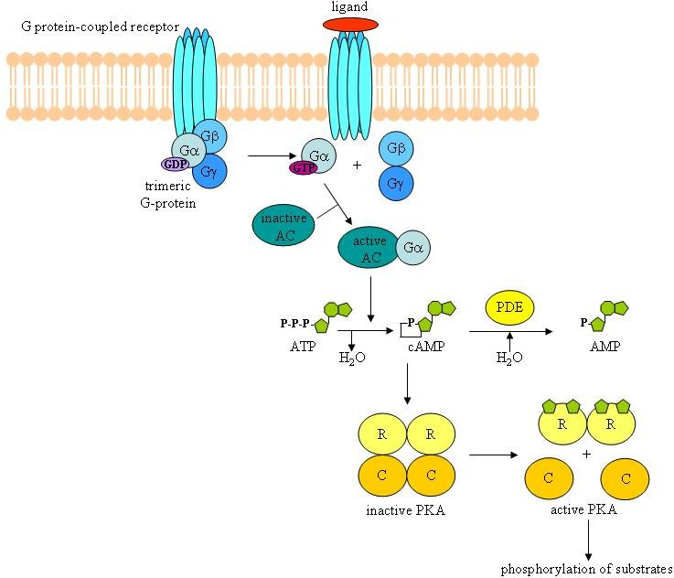
Epinephrine Binds B-AR/Gs in Skeletal Muscle, Liver and Fat Tissue

Slide 63
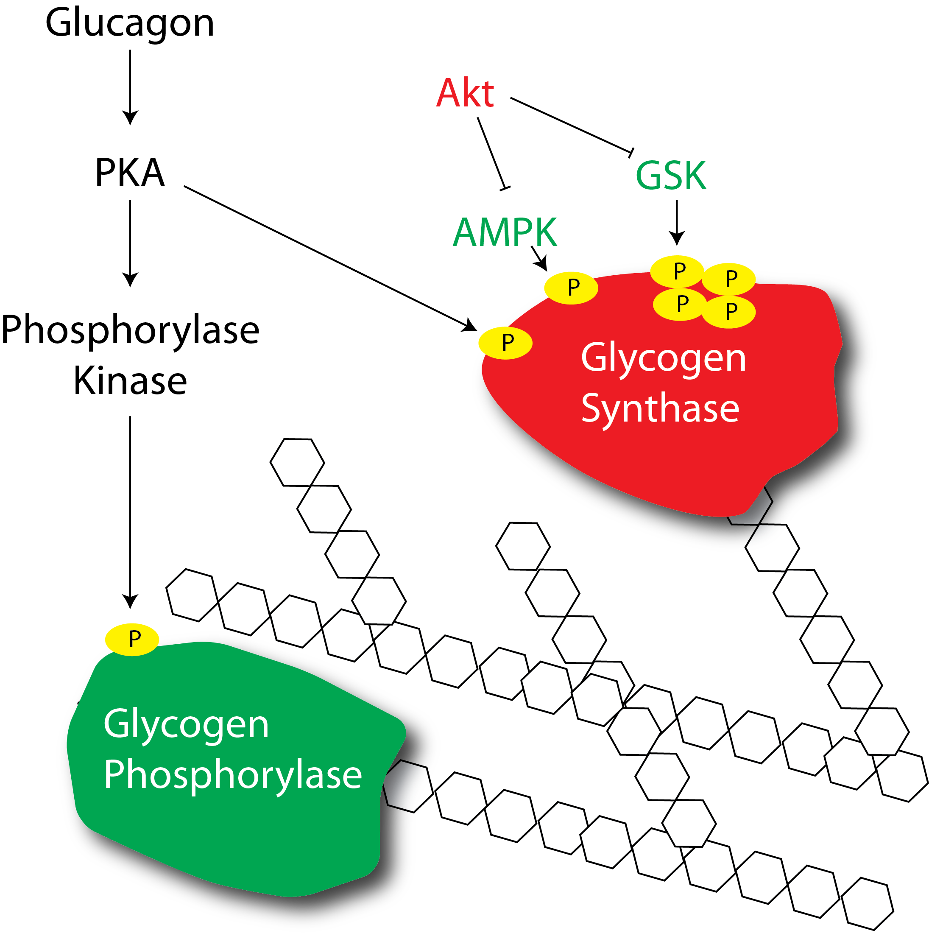
Epinephrine Mediated Activation of Glycogenolysis

Slide 64
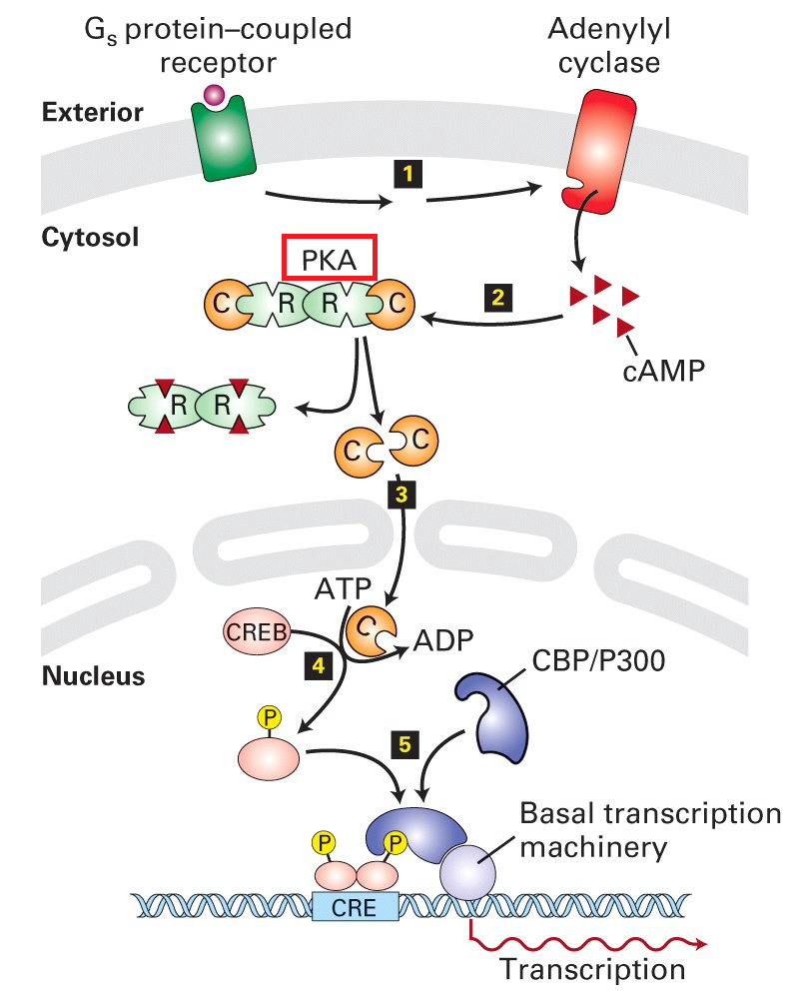
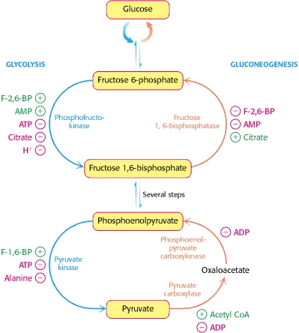
Dual Effects of Epinephrine on Gluconeogenesis in the Liver
PKA
PFK-2
Post-Translational Induction of Gluconeogenesis
Gluconeogenic Gene Transcription

Slide 65
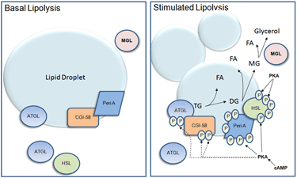
Effects of Epinephrine on Lipid Breakdown

Slide 66
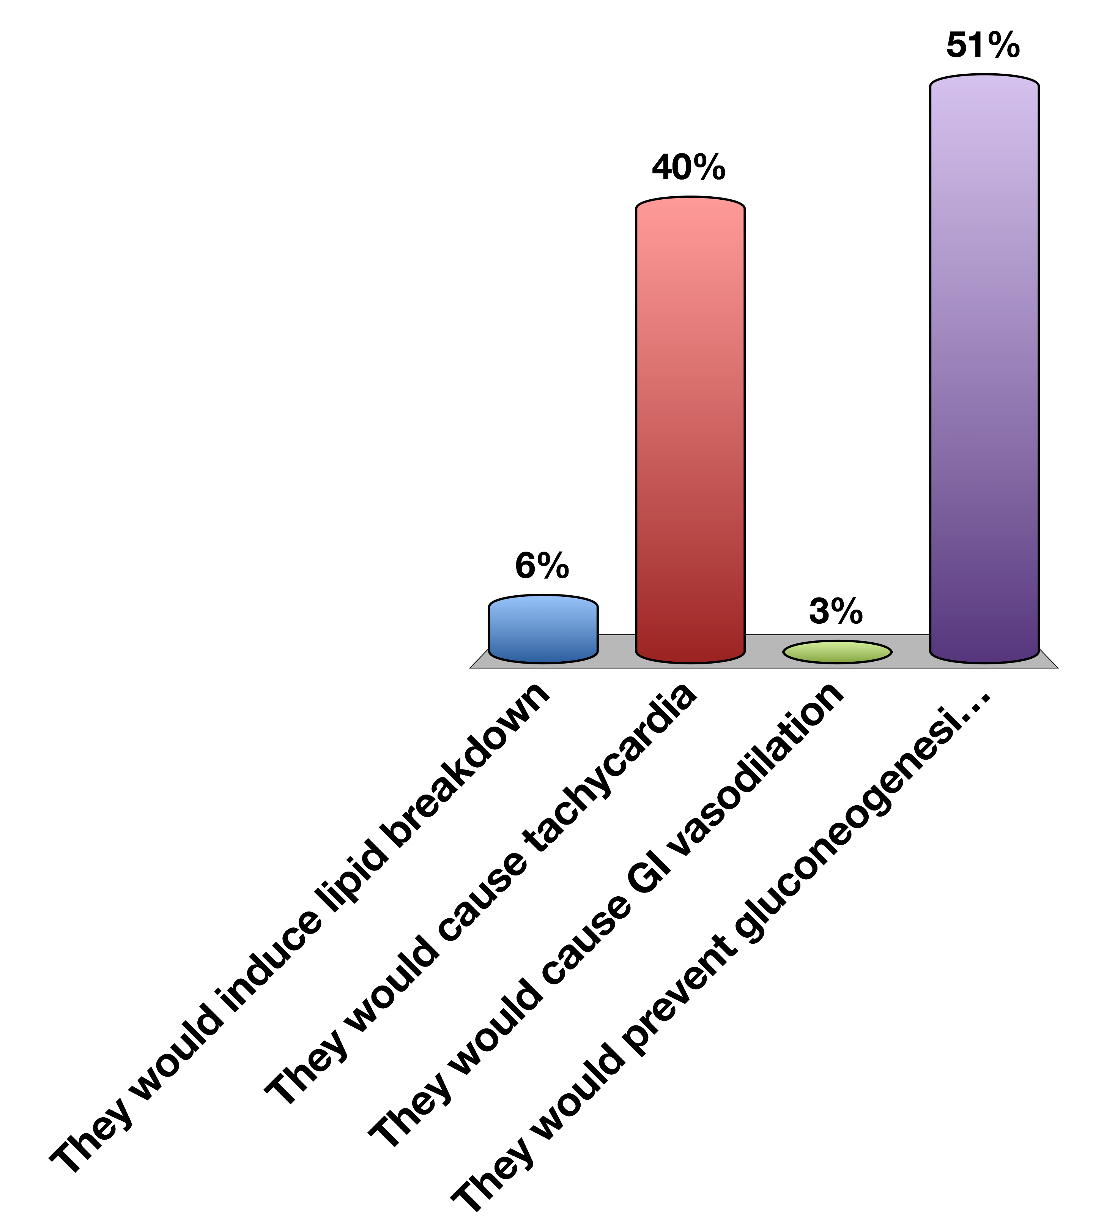
β-AR agonists would be good weight loss drugs except…
They would induce lipid breakdown
They would cause tachycardia
They would cause GI vasodilation
They would prevent gluconeogenesis in the liver
0

Slide 67
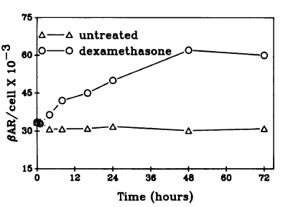
Short Term and Long Term Stress
Chronic Stress
Acute Stress
Cortisol
Epinephrine
Elevated Transcription of
Beta-Adrenergic
Receptors
Glucocorticoid
Receptor
Higher sensitivity
towards epinephrine
Hadcock JR, Malbon CC (1988) Regulation of beta-adrenergic receptors by “permissive” hormones: glucocorticoids increase steady-state levels of receptor mRNA. Proc Natl Acad Sci U S A 85: 8415–8419. doi:10.1073/pnas.85.22.8415.

Slide 68
Pheochromocytoma
Tumor that constitutively secretes adrenaline or noradrenaline
What cardiovascular and molecular phenotypes would this person have?
How could you treat this person?
Notes:
Spend some time discussing

Slide 69
Learning Objectives
Name three zones in the adrenal cortex and major regulator(s) of each zone.
Name three steroidogenesis pathways and their major products.
Explain briefly the physiological mechanism of adrenogenital syndrome.
Describe the physiological actions and roles of aldosterone.
Explain briefly the renin-angiotensin system.
Describe the negative feedback regulation of aldosterone and its relationship to blood volume/blood pressure homeostasis.
Describe hepatic and extrahepatic metabolic actions of glucocorticoids. Discuss their relationship.
State the major findings caused by adrenal hypersecretion of mineralocorticoids.
State the major findings caused by adrenal hypersecretion of glucocorticoids.
Name the major hormones secreted from the adrenal medulla. Discuss the differences of epinephrine (epi) and norepinephrine (NE) in cardiovascular actions (physiological levels).
List the major metabolic actions of catecholamines.
Contrast the thresholds for actions vs. plasma levels of epi and NE under common conditions, like exercise, and in the disease pheochromocytoma

Slide 70
Endocrine Control of Growth

Slide 71
Learning Objectives
List the hormones important for growth at key times in a person's life.
Describe the functions of human growth hormone on growth (bones and soft tissues), and on metabolism, and the regulation of its secretion. Explain what 'rhGH' means.
State the "dual effector hypothesis" for GH actions, and the relative roles of GH and IGF-1 in growth control.
Describe the interactions among all the key growth-regulating hormones at key times of a person's life: in utero, neonatally, childhood, puberty, adulthood, and senescence.
Describe the daily regulation of GH levels and the physiological relevance of these cycles.

Slide 72
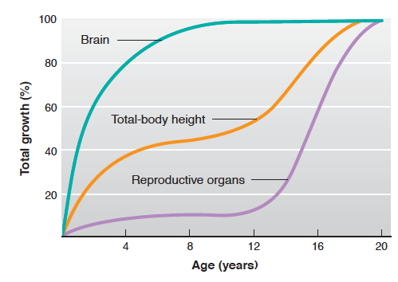
Human Organ Growth

Slide 73
Hormones During Growth
Stage | Age | Hormonal Requirements
Prenatal | (9 months) | Insulin
Infantile | 0-1 | Insulin
Juvenile | 1-12 years | GH, Insulin, T3, Vitamin D
Adolescent (Pubertal) | 10-14 (F) 12-16 (M) | GH, insulin, T3, Vitamin D and Sex Steroids
Adult | Puberty – 100 | Normally limited growth

Slide 74
Growth Hormone Summary
What chemical type is it? | Protein
Where is it made? | Somatotropes of Anterior Pituitary
What causes its release? | GHRH release (also regulated by somatostatin)
What is its receptor? | Growth Hormone Receptor | JAK/STAT
What tissues does it affect? | Liver | IGF-1 Release
 | Bones | Growth
 | Muscle | Protein Synthesis
 | Adipose Tissue | Lipolysis
How does it get turned off? | IGF Negative Feedback to Pituitary and Hypothalamus. GH/IGF1 Stimulation of somatostatin and receptor desensitization

Slide 75
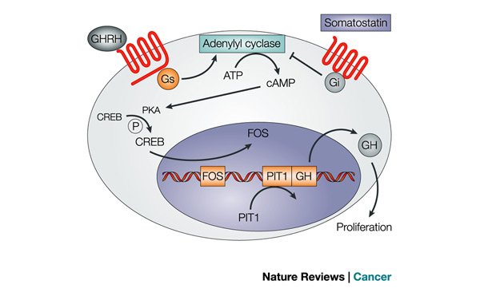
Regulation of GH Release

Slide 76
GH Decreases with Aging
Think of some possible mechanisms by which this could happen?
Less GH synthesis
Less GHRH responsiveness
Less GHRH synthesis
More SST synthesis
More SST responsiveness
Notes:
Less GH synthesis
Less GHRH responsiveness
Less GHRH synthesis
More SST synthesis
More SST responsiveness

Slide 77
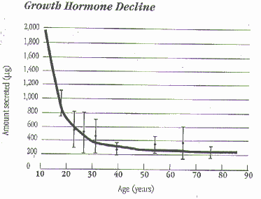
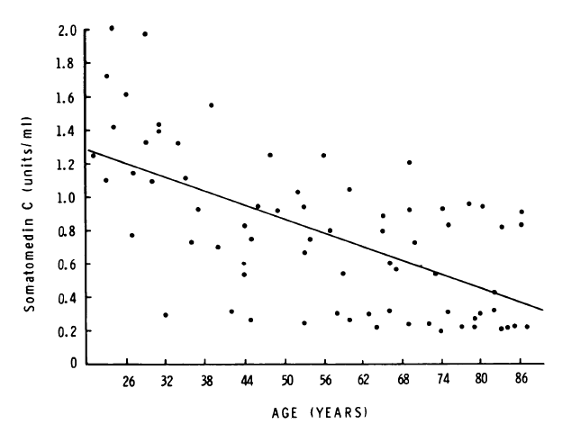
GH and Aging
GHRH Levels
Rudman D, Kutner MH, Rogers CM, Lubin MF, Fleming G a., et al. (1981) Impaired growth hormone secretion in the adult population. Relation to age and adiposity. J Clin Invest 67: 1361–1369. doi:10.1172/JCI110164.

Slide 78

Diurnal Rhythms of GH Release
Notes:
Discuss advantages of GH peaking at night

Slide 79

Growth Hormone Causes IGF-1 Release

Slide 80

Growth Hormone Receptor

Slide 81
IGF-1 Summary
What chemical type is it? | Protein
Where is it made? | Liver
What causes its release? | GH Signaling
What is its receptor? | IGF1R | Receptor Tyrosine Kinase
What tissues does it affect? | Liver | IGF-1 Release
 | Bones | Chondrocyte replication
 | Muscle | Protein Synthesis
How does it get turned off? | Receptor desensitization, Less GH production, IGF-1 degradation

Slide 82


Regulation of Bone Growth

Slide 83

Regulation of Muscle Growth

Slide 84

Effects of GH/IGF1 on Metabolism
Notes:
Dual efffector hypothesis

Slide 85

Can you recapitulate all the effects of GH by Providing IGF-1?
True
False
0
Notes:
Dual-effector hypothesis

Slide 86

Negative Feedback of GH

Slide 87

Other Hormones Influencing Growth

Slide 88

T3, Cortisol and GH Synthesis
Yaffes BM, Samuels HH (1984) Hormonal Regulation of the Growth Hormone Gene. J Biol Chem 259: 6284–6291.

Slide 89


Treatment of Hypothyroidism

Slide 90

Acromegaly
Pituitary tumor of the somatotropes
Overproduction of GH
Clinical presentation
Bone growth
Protruding brow and jaw, spacing of teeth
Low body fat increased muscle
Insulin resistant/diabetic

Slide 91
Dwarfism/Growth Hormone Deficiency
Congenital or immune destruction of somatotropes
Can be GH deficiency or GH resistance
Can be secondary to hypothyroidism
Clinical features
Reduced height
Reduced muscle mass
Elevations in fat mass
Resistance to diabetes
Notes:
70% of cases are In the context of achondroplasia, this mutation causes FGFR3 to become constitutively active, inhibiting bone growth

Slide 92
Learning Objectives
List the hormones important for growth at key times in a person's life.
Describe the functions of human growth hormone on growth (bones and soft tissues), and on metabolism, and the regulation of its secretion. Explain what 'rhGH' means.
State the "dual effector hypothesis" for GH actions, and the relative roles of GH and IGF-1 in growth control.
Describe the interactions among all the key growth-regulating hormones at key times of a person's life: in utero, neonatally, childhood, puberty, adulthood, and senescence.
Describe the daily regulation of GH levels and the physiological relevance of these cycles.

